Slide 1
OBJECT ORIENTED PROGRAMMING
Lecture #1: Introduction
by
Mrs. Akhila Pragada

Slide 2
JAVA IS _____
simple programming language
one of the most popular programming language
open-source and free
has a huge community support (tens of millions of developers)
close to C & C++
it helps to create modular programs and reusable code
write a program once and then run this program on multiple operating systems
works on different platforms (Windows, Mac, Linux, Raspberry Pi, etc.)
Java is a high-level, object-oriented programming language

Slide 3
JAVA IS USED
Mobile applications (specially Android apps)
Desktop applications
Web applications
Gaming Applications
Cloud-based Applications
Software Tools
Database connection
And much, much more!

Slide 4







COMPANIES THAT USE JAVA

Slide 5
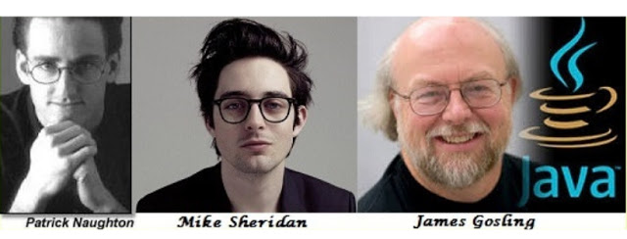
JAVA HISTORY
Developed by Sun Microsystems Inc in 1991
Initially named as Oak, later changed to Java
First publicly available version – Java 1.0 released in 1995
Oracle corporation acquired Sun Microsystems in 2010
The latest version of Java is Java 14 or JDK 14 released on March, 17th 2020

Slide 6
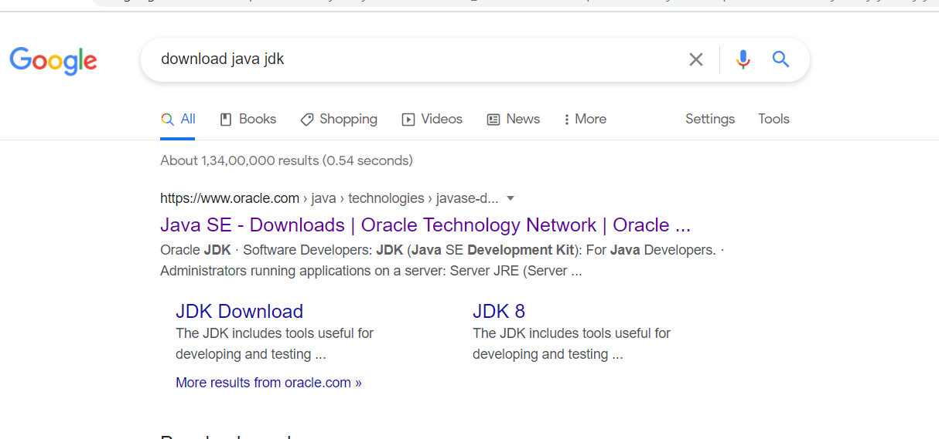
INSTALLATION

Slide 7
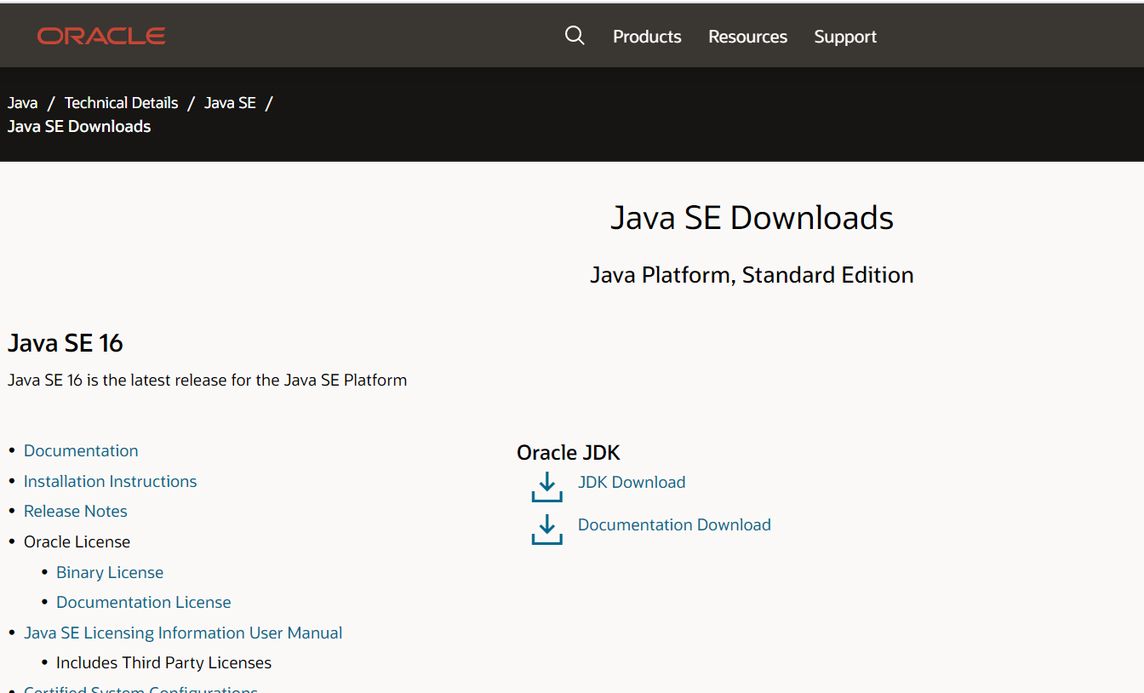
INSTALLATION

Slide 8
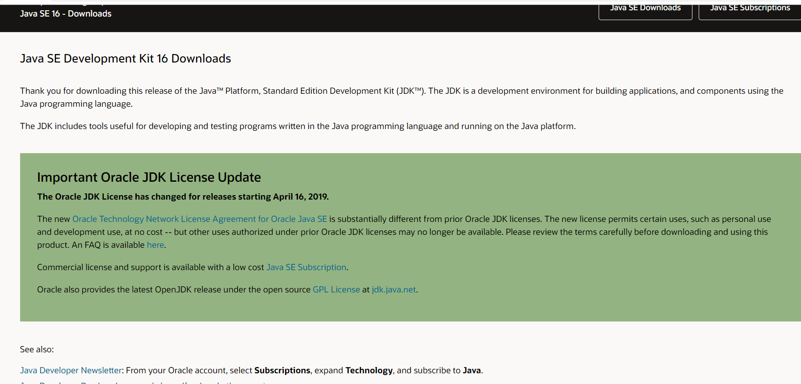

Slide 9
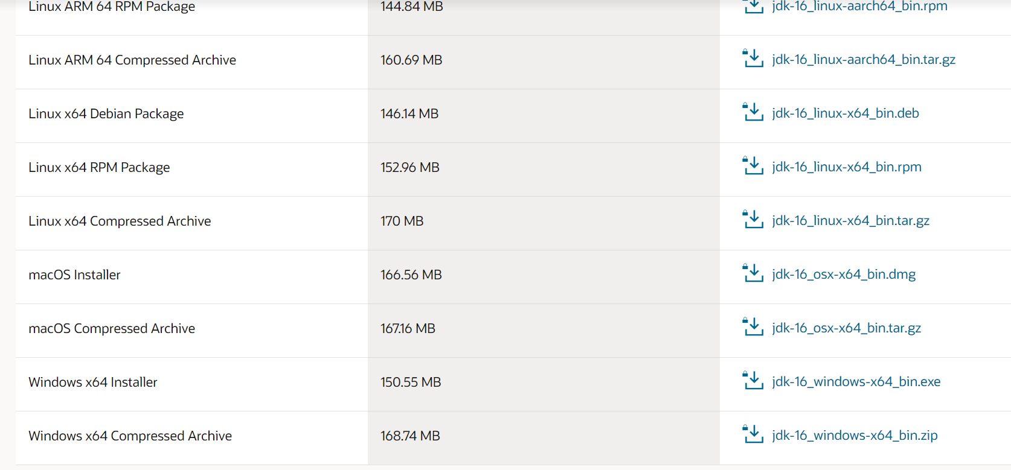
INSTALLATION

Slide 10
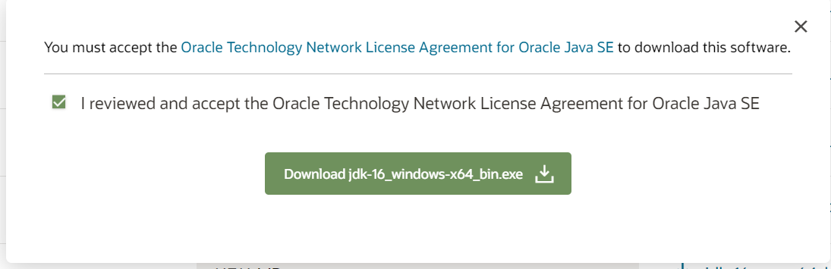
INSTALLATION

Slide 11
OBJECT ORIENTED PROGRAMMING
Lecture #2: POP vs OOP
by
Mrs. Akhila Pragada

Slide 12
PROGRAMMING LANGUAGES
Programming languages
Procedure Oriented languages
Object Oriented languages

Slide 13
PROCEDURE ORIENTED PROGRAMMING (POP)
Large Programs are divided into sequence of functions (Procedures)
Each procedure can be called by another procedure during execution by calling it using its name
In POP main focus is on procedures only not on data
Follows “Top-Down Approach”.
Program
Function 1
Function 2
Function 3

Slide 14
PROCEDURE ORIENTED PROGRAMMING (POP)
Global variables can be accessed by all functions
No security to data - Data can be freely moved from one procedure to another procedure
If we need to change the type of data of global variable then we need to revise all the functions that are using this global variables. Failing this may result in errors
POP does not model real world problems very well. Because functions are action oriented
Examples: C, PASCAL, COBOL, BASIC, FORTRAN
Global Variables 1
Global Variables 2
Function 1
Local variables
Function 2
Local variables
Function 3
Local variables

Slide 15
OBJECT ORIENTED PROGRAMMING (OOP)
In OOP data is secured -does not allow it to flow freely among functions
Program is divided into objects and then built functions and data around these objects.
Student Object
Object 1
Object 2
Name
Rollno
Age
Branch
Data
Data
Functions
Functions
Attendance
Percentage
Data
Object 3
Functions

Slide 16
OBJECT ORIENTED PROGRAMMING (OOP)
Data of an object is accessed only by the functions associated by that object
Objects communicate with each other through functions
In OOP emphasis is given to data rather than procedures
OOP follows “Bottom-Up Approach”
Examples: Java, VB.Net, C#
Main Program
Function 1
Function 2
Function 3

Slide 17
POP VS OOP
Procedure Oriented Programming
Object Oriented Programming
Program is divided into smaller programs called Procedures
Top-Down Approach
Importance is given to procedures rather than data
No security to data
Does not model real-world problems very well
Suitable for developing medium size projects
Program is divided into entities called Objects
Bottom-Up Approach
Importance is given to data rather than Procedures/functions
Data is Secure
Model real-world problems
Suitable to developing large size projects

Slide 18
C VS JAVA
C
Java
Procedure Oriented Programming Language
Complied
Supports Preprocessor Directives
User takes care of memory management
Uses pointers
Platform dependent
Variable declaration at the beginning of the block
Uses global variable
Object Oriented Programming Language
Complied & Interpreted
Does not support preprocessor directives
Internally manages the memory
Does not use pointers
Platform independent
Variable can be declared anywhere
No global variable

Slide 19
OBJECT ORIENTED PROGRAMMING
Lecture #3: Features of Java

Slide 20
CHARACTERISTICS OF OOP
Object
Class
Data Abstraction
Encapsulation
Inheritance
Polymorphism
Dynamic Binding
Message Passing

Slide 21
CLASS & OBJECT
A class is a data type that allows programmers to create objects. A class provides a definition for an object, describing an object’s attributes (data) and methods (operations).
An object is an instance of a class. With one class, you can have as many objects as required.
This is analogous to a variable and a data type, the class is the data type and the object is the variable.

Slide 22
DATA ABSTRACTION
Data abstraction is the process of hiding certain details and showing only essential information to the user.

Slide 23
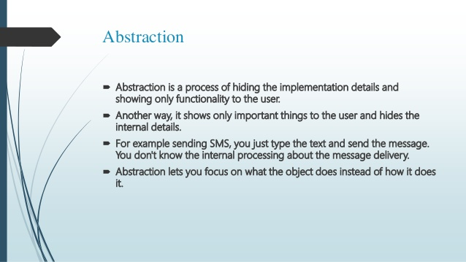
ABSTRACTION

Slide 24
ENCAPSULATION
Encapsulation is a mechanism of wrapping the data (variables) and code acting on the data (methods) together as a single unit.

Slide 25
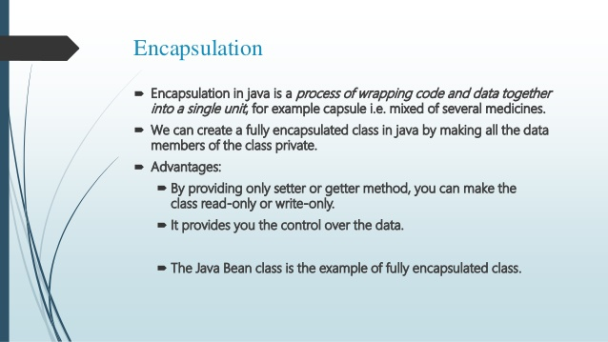
ENCAPSULATION

Slide 26
INHERITANCE
Inheritance can be defined as the process where one class acquires the properties (methods and fields) of another class.

Slide 27
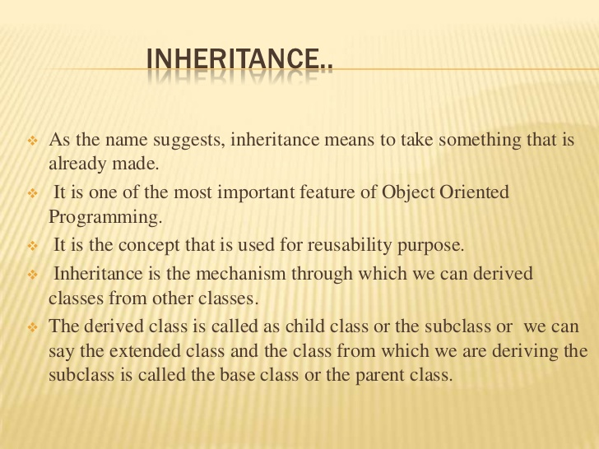

Slide 28
POLYMORPHISM
An operation exhibits different behaviors in different instances

Slide 29
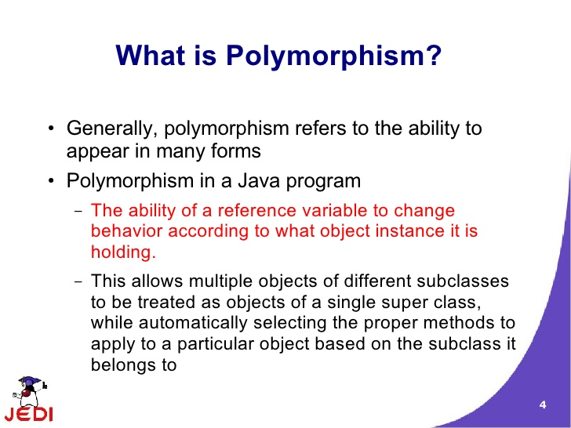

Slide 30
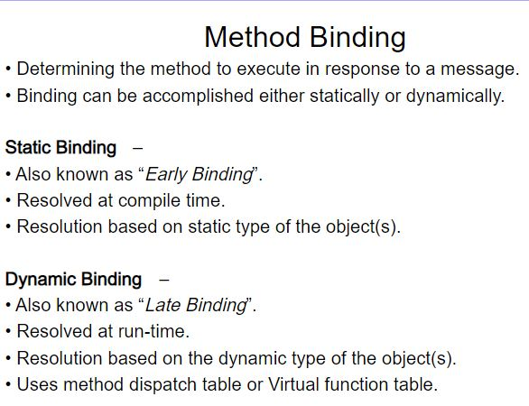

Slide 31
DYNAMIC BINDING
Dynamic binding also called dynamic dispatch is the process of linking procedure call to a specific sequence of code (method) at run-time.
It means that the code to be executed for a specific procedure call is not known until run-time.
Dynamic binding is also known as late binding or run-time binding.

Slide 32
MESSAGE PASSING
Message Passing is nothing but sending and receiving of information by the objects same as people exchange information.

Slide 33
FEATURES OF JAVA
Object
Class
Data Abstraction
Encapsulation
Inheritance
Polymorphism
Dynamic Binding
Message Passing
Platform independent
Compiled and interpreted
Robust and secure
Distributed
Multi-threading
Dynamic and extensible

Slide 34
JAVA BUZZWORDS
Platform independent
“Write once and run anywhere”
Secure
Based on public key encryption and helps to design virus free systems
Architectural and Neutral
Ability of generating Architectural-neutral objects that can run on multiple processors
Portable
Uses a compiler that is written using ANSI C and POSIX sub suit making it portable
Robust
Eliminates the most number of errors in the compile time itself
Multi-Threading
Capable to execute code simultaneously above multiple processors at a time.

Slide 35
OBJECT ORIENTED PROGRAMMING
Lecture #4: First Java program

Slide 36
JAVA VIRTUAL MACHINE (JVM)
Byte Code
Execute (JVM)
Java File
Compiler
Output
.class file

Slide 37
SIMPLE JAVA PROGRAM
class classname
{
public static void main (String a[])
{
Block of statements
}
}
class First
{
public static void main (String a[])
{
System.out.print(“First java program”);
}
}
Note:
Java is case sensitive
class name first letter should be capital
Every statement should end with semicolon
keywords:
class, public, static, void

Slide 38
COMPILING AND EXECUTING
Byte Code
Execute (JVM)
Java File
Compiler
Output
.class file
Saving:
First.java
Compiling:
javac First.java
Execution:
java First
Settig class path

Slide 39
OBJECT ORIENTED PROGRAMMING
Lecture #5: Compiling & Executing Javaprogram (Setting classpath)

Slide 40
SIMPLE JAVA PROGRAM
class First
{
public static void main (String a[])
{
System.out.print(“First java program”);
}
}
Note:
Java is case sensitive
class name first letter should be capital
Every statement should end with semicolon
keywords:
class, public, static, void

Slide 41
COMPILING AND EXECUTING
Byte Code
Execute (JVM)
Java File
Compiler
Output
.class file
Saving:
First.java
Compiling:
javac First.java
Execution:
java First
Setting class path

Slide 42
OBJECT ORIENTED PROGRAMMING
Lecture #6: Structure of Java Program

Slide 43
STRUCTURE OF JAVA PROGRAM
Documentation Section
Package Statements
Import Statements
Optional
Interface Statements
Class Definitions
Main method class
{
main method
definition
}
Essential

Slide 44
DOCUMENTATION SECTION
Used for writing comment lines
Ignored by compiler
3 ways:
//
This is for single line Ex: //Welcome to Java program
/* */
This is for multiple lines Ex: /* Welcome to
Java Program */
/** */
This is used to generate automatic comment

Slide 45
PACKAGE STATEMENT
Java packages are a mechanism to group Java classes that are related to each other, into the same "group" (package)
Ex: package Employee

Slide 46
IMPORT STATEMENTS
To import java package into a class, we need to use java import keyword which is used to access package and its classes into the java program
Can import built-in and user-defined packages
Ex: import java.lang.Math.*;
Import java.util.*;

Slide 47
INTERFACE STATEMENTS
Used to achieve multiple inheritance

Slide 48
CLASS DEFINITIONS
Any number of classes can be defined
All the objects of class should be created in main method.
One class should have main method—Main method class
Class Definitions
Optional
Main method class
{
main method
definition
}
Essential

Slide 49
OBJECT ORIENTED PROGRAMMING
Lecture #7: Variables & Datatypes

Slide 50
VARIABLE
A Java variable is a piece of memory that can contain a data value.
Variables are typically used to store information
Variable Declaration:
Variable Assignment:
Assigning a value to a variable
Syntax:
datatype variable name;
Example:
int a;
Syntax:
variable name=value;
Example:
a=10;

Slide 51
VARIABLE
Variable Naming Conventions:
Java variable names are case sensitive. The variable name apple is not the same as Apple or APPLE.
Java variable names must start with a letter, or the $ or _ character.
After the first character in a Java variable name, the name can also contain numbers (in addition to letters, the $, and the _ character).
Variable names cannot be equal to reserved key words in Java. For instance, the words int or for are reserved words in Java. Therefore you cannot name your variables int or fo

Slide 52
DATATYPES IN JAVA
Data type specifies the size and type of values that can be stored in an variable.
Derived Datatype
DataType
Primitive
Non-Primitive
Numeric
Non-Numeric
classes
Array
Integer
Floating Point
Char
Boolean
Interface

Slide 53
INTEGER
Integer types can hold whole numbers such as 123 and −96.
The size of the values that can be stored depends on the integer type that we choose.
1 byte = 8 bits
Type
Size
Range of values that can be stored
byte
1 byte
−128 to 127
−128 to 127
short
2 bytes
−32768 to 32767
−32768 to 32767
int
4 bytes
−2,147,483,648 to 2,147,483,647
Example:
inr a;
byte b;
a=10;
long
8 bytes
9,223,372,036,854,775,808 to 9,223,372,036,854,755,807
The range of values is calculated as −(2^{n−1}) to (2^{n−1})−1; where n is the number of bits required.

Slide 54
FLOATING POINT
Floating point data types are used to represent numbers with a fractional part.
There are two subtypes:
Type
Size
Range of values that can be stored
float
4 byte
3.4e−038 to 3.4e+038
double
8 bytes
1.7e−308 to 1.7e+038
Example:
float a;
double b;
a=4.7;

Slide 55
CHARACTER
It stores character constants in the memory
It assumes a size of 2 bytes
Basically it can hold only a single character
Keyword: char
Keep the value in single quote.
Example:
char a;
char b;
a=‘k’;
b=‘2’;

Slide 56
BOOLEAN
Boolean data types are used to store values with two states: true or false.
Its size is 1 bit
Keyword: boolean
Example:
boolean a;

Slide 57
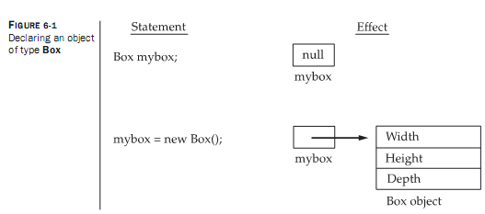
OBJECT DECLARATION

Slide 58
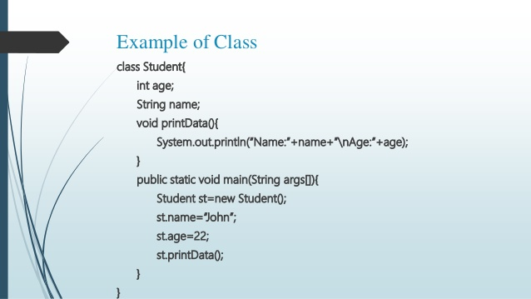
EXAMPLE PROGRAM

Slide 59
BASIC PROGRAM DEVELOPMENT
Edit and
save program
errors
errors
Compile program
Execute program and
evaluate results

Slide 60
Java Environment/
Life Cycle of Java Code
Compile-time Environment
Runtime Environment
Class Loader
Bytecode
Verifier
Java Class
Libraries
Java
Source
(.java)
Java
Interpreter
Just in Time
Compiler
Java
Bytecodes
move locally
or through
network
Java
Virtual
machine
Java
Compiler
Runtime System
Java
Bytecode
(.class )
Operating System
Hardware

Slide 61
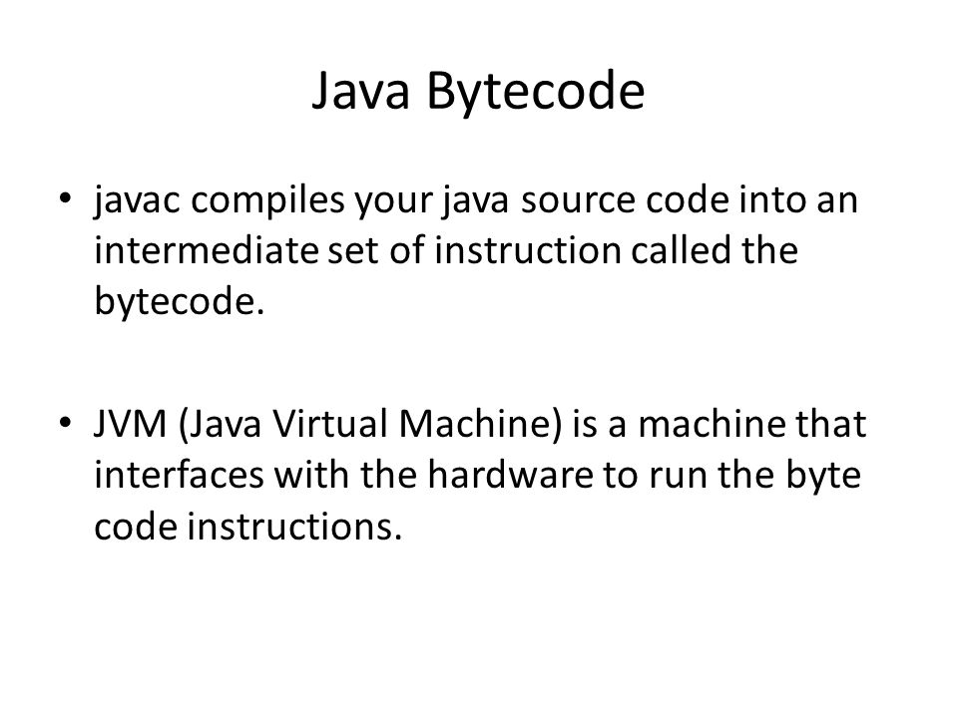
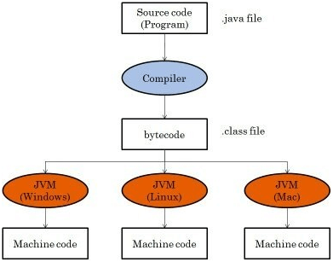

Slide 62
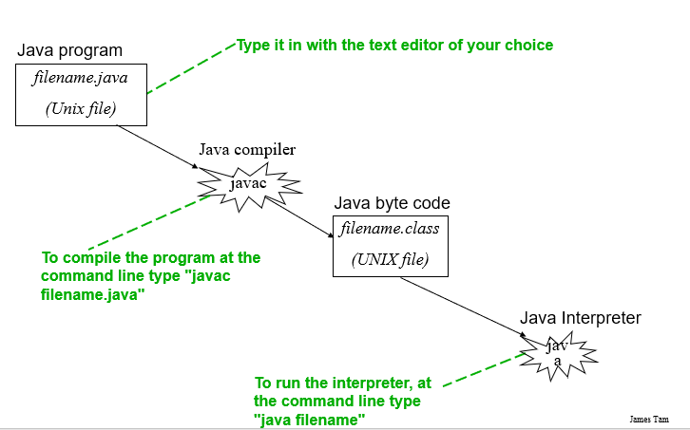
CREATING, COMPILING AND RUNNING JAVA PROGRAMS

Slide 63
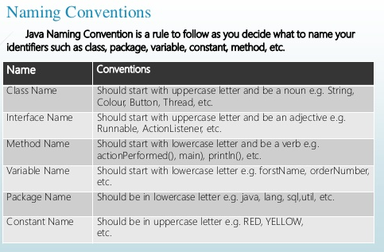

Slide 64
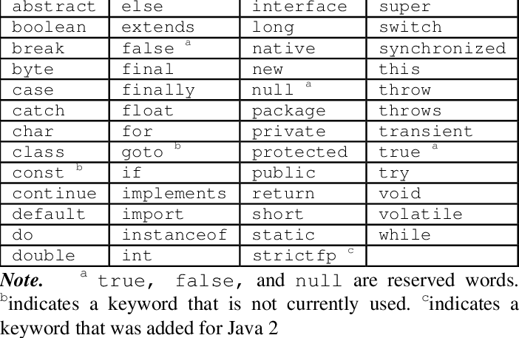
JAVA KEYWORDS

Slide 65
OPERATOR EVALUATION
Parentheses have the highest precedence and it can be used to force an expression to evaluate in order you want.
(3-1) is 2 and(1+1) **(5-2) is 8. you can also use parentheses to make an expression easier to read, as in (min*100)/60, even though it does not change the result.
Exponentiation has the next highest precedence, so 2**1+1 is 3 and not 4 and 3*1**3 is 3 and not 27.
Multiplication and division have the same precedence which is higher than addition and subtraction which also has the same precedence. So 2*3-1=5 and 2/3-1=-1(integer division, 2/3=0).
Operators with the same precedence are evaluated from left to right. So in the expression min*100/60, the multiplication operation takes first place, yielding 5900/60 which in turn yields 98.
If the operations had been evaluated from right to left, the result would have been 59*1 that produce the result as 59 which is wrong

Slide 66
EXAMPLE:
12+20*2-4*2/2.0 # 48.0
1. 12+40-4*2/2.0
2. 12+40-8/2.0
3. 12+40-4.0
4. 52-4.0
5. 48.0
12+(20*2)-4*(2/2.0) # 48.0
12+(20*2)-(4*2)/2.0 # 48.0
expression is evaluated from left -> right. BODMAS(bracket of division multiplication) rule is followed while evaluating the expression.

Slide 67
OBJECT ORIENTED PROGRAMMING
Lecture #8: Control Statements in Java
(Part-1)

Slide 68
CONTROL STATEMENTS
Control Statements
Selection Statements
Transfer Statements
Iterative Statements

Slide 69
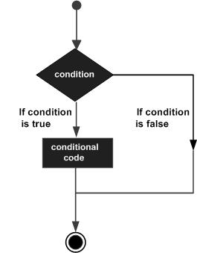
SELECTION STATEMENTS (if)
“Simple if”
Syntax:
if(condition)
{
block1- stmt1
block1-stmt2
}
Flow Chart
Example
//checking the age
if(age>18)
System.out.print("Age > 18");

Slide 70
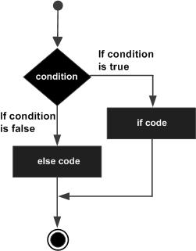
SELECTION STATEMENTS (if)
“if-else Statement”
Syntax:
if(condition)
{
block1-stmt1
block1-stmt2
}
else
{
block2-stmt1
block2-stm2
}
Flow Chart
Example
if( x < 20 )
{
System.out.print(“Yes");
}
else
{
System.out.print(“NO”);
}

Slide 71
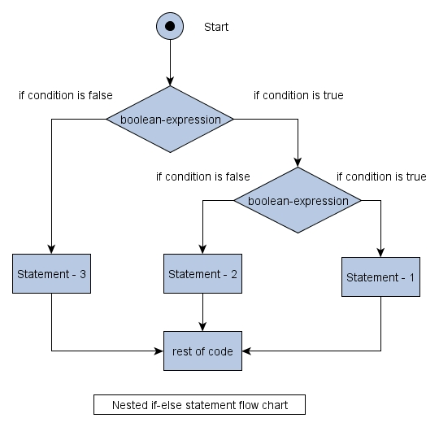
SELECTION STATEMENTS (if)
“Nested if-else Statement”
Syntax:
if(condition)
{
if(condition)
{
block1-stmt1
block1-stmt2
}
else
{
block2-stmt1
block2-stm2
}
}
else
{
block3-stmt1
block3-stm2
}
}
Flow Chart
Example
if( a>b)
{
if(a >c)
System.out.print(“A is big");
else
System.out.print(“b is big");
}
else
{
if(b >c)
System.out.print(“B is big");
else
System.out.print(“b is big");
}

Slide 72
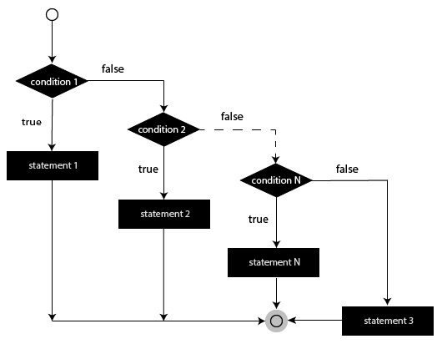
SELECTION STATEMENTS (if)
“else-if Ladder Statement”
Syntax:
if(condition)
{
block1-stmt1
block1-stmt2
}
else
{
if(condition)
{
block2-stmt1
block2-stmt2
}
else
{
block3-stmt1
block3-stm2
}
}
Flow Chart

Slide 73
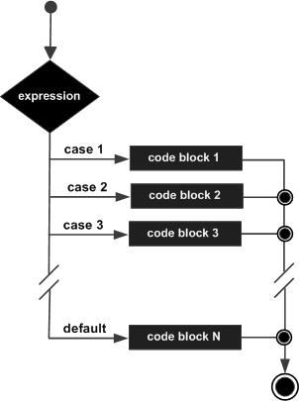
SELECTION STATEMENTS (switch)
“switch Statement”
Syntax:
switch(expression)
{
case value :
// Statements
break; // optional case value :
// Statements
break; // optional
// You can have any number of case statements.
default : // Optional
// Statements
}
Flow Chart
Example
switch(grade)
{
case 'A' :
System.out.println("Excellent!");
break;
case 'B' :
case 'C' :
System.out.println("Well done");
break;
case 'D' :
System.out.println(“Passed");
break;
case 'F' :
System.out.println(“Fail");
break;
default :
System.out.println("Invalid grade"); }

Slide 74
OBJECT ORIENTED PROGRAMMING
Lecture #9: Control Statements in Java
(Part-2)
by

Slide 75
CONTROL STATEMENTS
Control Statements
Selection Statements
Transfer Statements
Iterative Statements

Slide 76
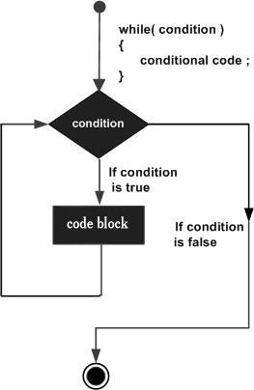
ITERATIVE STATEMENTS (while)
“while”
Repeatedly executes the block of statements as long as the condition is true
Entry-controlled Loop
FlowChart
Syntax:
while(expression)
{
block1- stmt1
block1-stmt2
}
Example:
x=0
while( x<10)
{
System.out.println(x);
x=x+1;
}
print(“End of while”)

Slide 77
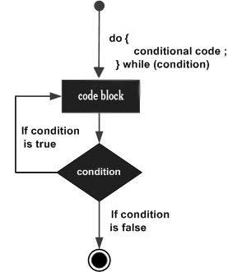
ITERATIVE STATEMENTS (do-while)
“do-while”
Repeatedly executes the block of statements until the condition becomes False
Exit-controlled Loop
FlowChart
Syntax:
do
{
block1- stmt1
block1-stmt2
} while(expression);
Example:
x=0
do
{
System.out.println(x);
x=x+1;
}
while( x<10);
print(“End of do-while”)

Slide 78
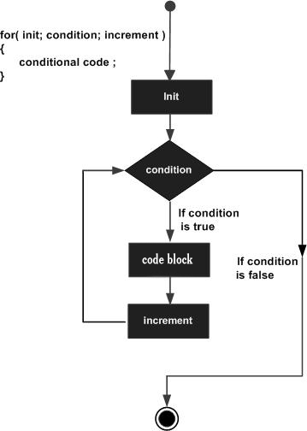
ITERATIVE STATEMENTS (for)
“for”
Flowchart
Syntax:
for(initialization; Boolean_expression; update)
{
// Statements
}
Example:
for(int x = 10; x < 20; x = x + 1)
{
System.out.print("value of x : " + x );
}

Slide 79
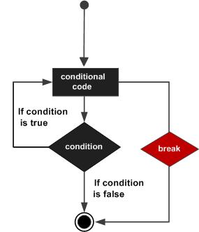
TRANSFER STATEMENTS (break)
“break”
When the break statement is encountered inside a loop, the loop is immediately terminated and the program control resumes at the next statement following the loop.
Flowchart
Syntax:
break;
Example:
for(int i = 1; i < 5; i ++)
{
if( i == 3 )
break;
System.out.println( i );
}
Output:
1
2

Slide 80
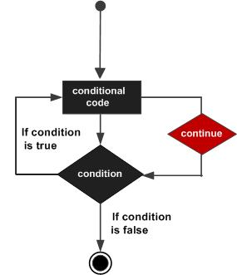
TRANSFER STATEMENTS (continue)
“continue”
In a loop, the continue keyword causes control to immediately jump to the next iteration.
Flowchart
Syntax:
continue;
Example:
for(int i = 1; i < 5; i ++)
{
if( i == 3 )
continue;
System.out.println( i );
}
Output:
1
2
4

Slide 81
PACKAGE DETAILS
Java user input(Scanner)
The Scanner class is used to get user input and it is found in the java.util package.
To use the scanner class, create an object of the class and use any of the available methods found in the scanner class documentation.
There are some input types in Scanner package
nextBoolean() – reads a Boolean value from the user
nextByte() – reads a byte value from the user
nextDouble() - reads a double value from the user
nextFloat() – reads a float value from the user
nextInt() – reads a int value from the user
nextLine() - reads a string from the user
nextLong() – reads a long value from the user
nextShort() – reads a short value from the user

Slide 82
JAVA LANG PACKAGE
For writing any java program, the most commonly required classes and interfaces are encapsulated in the separate packages which is nothing but java.lang package.
It is not required to import java package in our program because it is available by default to every java program.
The following are the some of the important classes present in java.lang package.
Object
String
String buffer
All wrapper classes
Exception API
Thread API…etc.

Slide 83
JAVA.LANG.OBJECT CLASS
For any java object whether it is predefined or customized the most commonly required methods are encapsulated into a separate class which is nothing but object class.
As object class act as a root (or) parent (or) super for all java classes , by default its methods are available to every java class.
The following are the list of all methods present in java.lang object class
public String toString()
public native int hashCode()
public boolean equals(Object o);
protected native Object clone() throws CloneNotSupportedException;
public final Class<?> getClass();
protected void finalize () throws Throwble;
public final void wait() throws InteruptedException;
public final void wait(long ms , int ns) throws InteruptedException;
public final native void notify();
public final native void notifyAll();

Slide 84
ACCESS MODIFIERS
Access modifiers in java specifies the accessibility or scope of the field, method, constructor, or a class.
We can change the access levels fields by applying the modifiers in it.
There are 4 access modifiers in java.
Public- for every where.
Private – only within the class. It cannot be accessed from the outside of the class.
Protected- with in the package and outside the package through child class.
Default – only with in the package.

Slide 85
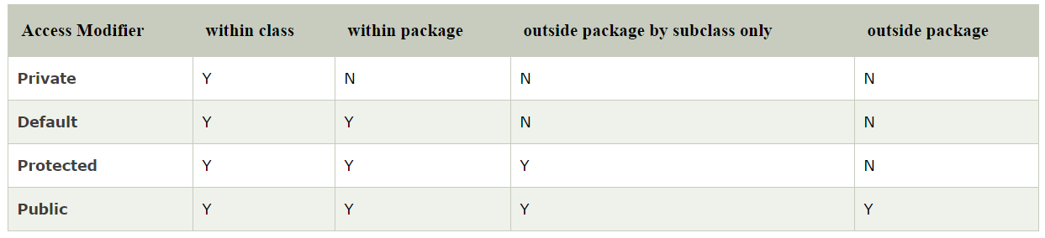
ACCESS MODIFIERS

Slide 86
TYPE CONVERSION
Converting one data type into another data type is known as type conversion
This is classified into 2 types
Automatic/ implicit type conversion
Explicit/ manual type conversion
Automatic Type Conversion:
It is possible to convert lower data type into higher data type .
Ex: byte a=5;
int b;
b=a;
This means a is of byte data type and b is int data type. If we write b=a means, a value is stored in b but the value is in int data type.
Explicit Type Conversion:
It is possible to convert higher data type into lower data type. But we may loss data while conversion.

Slide 87
EXAMPLE
Ex: if float is converted into short data type
Float data type occupies 4 bytes of memory
Short data type occupies 2 bytes of memory
So while converting from higher data type to lower data type we lost some data.
Syntax: var= (target) variable;
Ex: float a;
int x;
x=(int) a;
Which means, a is converted into int data type and the result will be stored in x which is already an integer data type.
So we are compressing the size of our data so this is nothing but type casting.

Slide 88
LEXICAL ISSUES
Java is a collection of
White spaces
Identifiers
Comments
Literals
Operators
Separators
Keywords

Slide 89
WHITE SPACES
Java is a free form language.
We don’t need to follow any special indentation rules
Ex: a program can be written in a single line or multi line or in any strange way , as long as there is at least one white space character between each token that is not already separated by an operator or separator.
In java , white space is a space or tab or new line

Slide 90
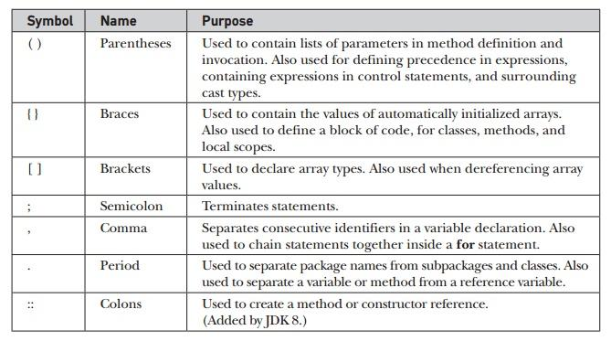
SEPARATORS

Slide 91
OBJECT ORIENTED PROGRAMMING
Lecture #10: Class & Object

Slide 92
CLASS DEFINITIONS
Any number of classes can be defined
One class should have main method—Main method class
All the objects of class should be created in main method.
Class Definitions
Optional
Main method class
{
main method
definition
}
Essential

Slide 93
CLASS
Defining a class:
A class can be defined as a template/blueprint that describes the behavior/state that the object of its type support.
Optional
Syntax:
[Access_Modifier] class class_name
{
Fileds declaration;
Methods declerations;
}
Variables
Members
Functions

Slide 94
CLASS
class_name:
Field declaration:
Example:
class Student
class Example
Instance variables are created at the time of object creation
Syntax:
[Access Modifier] type Variable_name;
[initial value]
Optional
Example:
int age;
float marks;
float studentHeight;
Instance Variable

Slide 95
CLASS
Method declaration:
Syntax:
[Access Modifier] returntype identifier (Paramenter_list)
{
method_body
}
Optional
Example:
int add( int x, float b)
{
statements
}
Example:
int getStudentData( int x, float b)
{
statements
}

Slide 96
CLASS- EXAMPLE
Example:
class Student
{
int a,b;
int add( int x, float b)
{
statements
}
}

Slide 97
OBJECT
An object is an instance of a class.
To create an object “new” operator is used
Object creation:
2 parts-
Declare the object
Instantiate the object
Example:
class Student
{
int a,b;
int add( int x, float b)
{
statements
}
}
Object creation:
Student obj;
obj=new Student();
Object creation:
Student obj=new Student();

Slide 98
OBJECT
Class creation:
class Student
{
int a,b;
int add( int x, float b)
{
statements
}
}
Accessing class members
using .(dot) Operator
Syntax:
objectname.variable_name=value;
objectname.methodname(parameter_list);
Example:
obj.a=10;
obj.add(25,33.5);
Object creation:
Student obj=new Student();

Slide 99
OBJECT
Multiple objects can be created from a single class
Class creation:
class Student
{
int rollno;
int add( int x, float b)
{
statements
}
}
Object creation:
Student s1=new Student();
Student s2=new Student();
Student s3=new Student();
s1.rollno=12;
s2.rollno=23;
s3.rollno=45;

Slide 100
PROGRAM WITH MULTIPLE CLASSES
class Example
{
int a,b,c;
void getData(int x, int y)
{
a=x;
b=y;
}
void add( )
{
c=a+b;
System.out.print(“Sum is :”+c);
}
}
class Addition
{
public static void main(String args[])
{
Example obj1=new Example();
obj1.getData(25,25);
obj1.add();
}
}
Output:
Sum is :50

Slide 101
PROGRAM WITH MULTIPLE CLASSES
class Example
{
int a,b,c;
void getData(int x, int y)
{
a=x;
b=y;
}
void add( )
{
c=a+b;
System.out.println(“Sum is :”+c);
}
}
Private class Addition
{
public static void main(String args[])
{
Example obj1=new Example();
obj1.getData(25,25);
obj1.add();
Example obj2=new Example();
obj2.getData(5,2);
obj2.add();
}
}
Output:
Sum is :50
Sum is :7

Slide 102
OBJECT ORIENTED PROGRAMMING
Lecture #11: Array in Java-Introduction

Slide 103
WHY ARRAY?
Array is used to hold more than one value with same variable name
Consider :
int a;
a=10;
a=20;
System.out.print(“a= “+a);
Consider :
int a;
a=10;
System.out.print(“a= “+a);
b=20;
System.out.print(“b= “+b);
Output:
a= 20
Output:
a= 10
b=20
A Variable will hold only one value at a time

Slide 104
ARRAY
Java array is an object which contains elements of a similar data type.
The elements of an array are stored in a contiguous memory location.
3 Steps:
Declaration of array
Instantiate the array
Initialization of array

Slide 105
ARRAY
Declaration of Array:
Specifying Array name and datatype
2 forms
Syntax(Form-1):
type array_name[ ];
Syntax(Form-2):
type[ ] array_name;
Example(Form-1):
int roll_no[ ];
Example(Form-2):
int[ ] roll_no;
Don’t Mention the size

Slide 106
ARRAY
Instantiate the Array:
Allocating the memory to the array
uses “new” operator
Combining Declaration & Instantiate the Array:
Example:
int roll_no[ ];
Syntax:
array_name= new type[ size];
Example:
roll_no=new int[5 ];
Syntax:
type array_name[ ]= new type[ size];
Example:
int roll_no[ ]=new int[5 ];

Slide 107
ARRAY
Memory Allocation:
roll_no
int roll_no[ ];
.
Points Nothing
roll_no
.
roll_no=new int[5 ];
roll_no[ 0]
roll_no[ 1]
Array in Java is index-based,
the first element of the array is
stored at the 0th index,
2nd element is stored on 1st index
and so on.
roll_no[ 2]
roll_no[ 3]
roll_no[ 4]

Slide 108
ARRAY
Example:
int roll_no[ ]=new int[5 ];
Initialization of Array:
Assigning values to the Array.
1. Compile-time:
Assigning individual array elements:
Combining declaration and initialization:
Syntax:
array_name[index]= value;
Example:
roll_no[0]= 10;
roll_no[1]= 20;
Syntax:
type array_name[ ]= {list of values};
Example:
int roll_no [ ]= {10,20,54,66,12};
In this case required memory will be automatically created, no need of “new” operator

Slide 109
ARRAY
Initialization of Array:
Reading values from user- Run-time
uses Scanner class (import java.util.*)
To read a variable value
To read array values
To print array values
int a;
Scanner s;
a=s. nextInt( );
int a[]=new int[5];
Scanner s;
for(i=0;i<5;i++)
{
a[i]=s. nextInt( );
}
Using for or foreach
for(i=0;i<5;i++)
{
System.out.println(a[i]);
}
for(int i : a)
{
System.out.println( i);
}

Slide 110
OBJECT ORIENTED PROGRAMMING
Lecture #12: Two Dimensional Array

Slide 111
TYPES OF ARRAY
Java array is an object which contains elements of a similar data type.
The elements of an array are stored in a contiguous memory location.
3 Steps:
Declaration of array
Instantiate the array
Initialization of array
3 types of Arrays:
One-Dimensional Array
Two-Dimensional Array
Multi-Dimensional Array

Slide 112
ONE-DIMENSIONAL ARRAY
Combining Declaration & Instantiate the Array:
Memory Allocarion:
Initialization:
Syntax:
type array_name[ ]= new type[ size];
Example:
int roll_no[ ]=new int[5 ];
.
roll_no
0
1
2
3
4
int a[]=new int[5];
Scanner s= new Scanner(System.in);
for(i=0;i<5;i++)
{
a[i]=s. nextInt( );
}
Syntax:
type array_name[ ]= {list of values};
Example:
int roll_no [ ]= {10,20,54,66,12};

Slide 113
TWO-DIMENSIONAL ARRAY
Used to store more than one value
Used to represent the data in the form of matrix or table
Declaration of Array:
Specifying Array name and data-type
Instantiate the Array:
Allocating the memory to the array
uses “new” operator
Syntax:
type array_name[ ][ ];
Example:
int a[ ][ ];
Syntax:
array_name= new type[ r-size][c-size];
Example:
a=new int[3][4];
Syntax:
type array_name[ ][ ]= new type [ r-size][c-size];
Example:
int a[ ][ ] = new int[3][4];;

Slide 114
TWO-DIMENSIONAL ARRAY
Memory Allocation:
Example:
int a[ ][ ] = new int[3][4];;
Individual element is accessed:
a[r-index][c-index]
0
1
2
3
0
1
First element: a[0][0]
Second element: a[0][1]
2
Third element: a[0][2]
12th element: a[2][3]

Slide 115
TWO-DIMENSIONAL ARRAY
Initialization of Array:
Assigning values to the Array.
1. Compile-time:
Assigning individual array elements:
Example:
int a[ ][ ]=new int[3 ][4];
Syntax:
array_name[r-index][c-index]= value;
Example:
a[0][0]= 10;
a[0][1]= 20;
a[1][2]=65;
a[2][3]=35;

Slide 116
TWO-DIMENSIONAL ARRAY
Combining declaration and initialization:
Syntax:
type array_name[r-size][c-size]= {list of values};
Example:
int a[3][2]= {10,20,54,66,12,77};
Example:
int a[3][2]= {{10,20},{54,66},{12,77}};
In this case required memory will be automatically created, no need of “new” operator
a[0][0] = 10
a[1][0] = 54
a[2][0] = 12
0
1
a[0][1] = 20
a[1][1] = 66
a[2][1] = 77
0
10
20
1
54
66
Values will be stored row by row
2
12
77

Slide 117
TWO-DIMENSIONAL ARRAY
Initialization of Array:
Reading values from user- Run-time
uses Scanner class (import java.util.*)
int a[][]=new int[3][2];
Scanner s= new Scanner(System.in);
for(i=0;i<3;i++)
{
for (j=0; j<2;j++)
{
a[i][j]=s. nextInt( );
}
}
To print array values
for(i=0;i<3;i++)
{
for (j=0; j<2;j++)
{
System.out.println(a[i][j]);
}
}

Slide 118
OBJECT ORIENTED PROGRAMMING
Lecture #13: Muli-Dimensional Array and Jagged Arrays

Slide 119
MULTI-DIMENSIONAL ARRAY
The Multi Dimensional Array in Java programming language is nothing but an Array of Arrays (Having more than one dimension).
Two Dimensional Array, which is the simplest form of Java Multi Dimensional Array.
we can declare n-dimensional array or Muti dimensional array by placing n number of brackets [ ], where n is dimension number.
3D-Array Declaration:
Instantiate the 3D-Array:
Syntax:
type array_name[ ][ ][ ];
Example:
int a[ ][ ][ ];
Syntax:
array_name= new type[Tables][ r-size][c-size];
Example:
a= new int[2][ 3][4];

Slide 120
MULTI-DIMENSIONAL ARRAY
Initialization of Array:
Assigning values to the Array.
1. Compile-time:
Assigning individual array elements:
Example:
int a[ ][ ][ ]=new int[2][ 3][4];
Syntax:
array_name[table_no][r-index][c-index]= value;
Example:
a[0][0][0]= 10;
a[0][0][1]= 20;
a[1][1][2]=65;
a[1][2][3]=35;

Slide 121
MULTI-DIMENSIONAL ARRAY
Combining declaration and initialization:
Syntax:
type array_name[tables][r-size][c-size]= {list of values};
Example:
int a[2][3][2]= {{ {5,6},{8,12},{7,90}} , {{10,20},{54,66},{12,77}}};
In this case required memory will be automatically created, no need of “new” operator

Slide 122
MULTI-DIMENSIONAL ARRAY
Initialization of Array:
Reading values from user- Run-time
uses Scanner class (import java.util.*)
To print array values
int a[][][]=new int[2][3][4];
Scanner s= new Scanner(System.in);
for(i=0;i<2;i++)
{
for (j=0; j<3;j++)
{
for(k=0;k<4;k++)
{
a[i][j][k]=s. nextInt( );
}
}
}
for(i=0;i<2;i++)
{
for (j=0; j<3;j++)
{
for(k=0;k<4;k++)
{
System.out.print(a[i][j][k]);;
}
}
}

Slide 123
JAGGED ARRAY
Jagged array is a multidimensional array where member arrays are of different size.
For example, we can create a 2D array where first array is of 3 elements, and is of 4 elements.
Program:
int a[ ][ ];
a=new int[3][ ];
a[0]=new int[4];
a[1]=new int[2];
a[2]=new int[3];
0
1
2
3
0
1
2

Slide 124
ARRAY PACKAGE
Array class is included in java.util package
It contains several static methods that you can use to compare, sort and search in arrays.
This class is a member of collection framework.
Different methods of this class are listed below.
Arrays.toString()
Arrays.asList()
Array.sort()
Array.binarySearch()
Array.copyOf()
Array.copyOfRange()
Arrays.fill() … etc.

Slide 125
METHODS IN ARRAYS
Arrays.ToString():
It returns the string representation of the array enclosed in the square braces[].
Adjacent elements are separated by the comma character.
Ex: int array[]={1,2,3,4,5,6,7};
System.out.println(Arrays.ToString(array));
Arrays.asList():
It returns a list backed by a given array . In other words, both the list and array refer to the same location
Ex: List integerList= Array.asList(array);// returns a fixed size list backed by the specified array.
Arrays.sort():
This method sorts the specified array into ascending numerical order.
Arrays.sort(array)

Slide 126
METHODS IN JAVA
Arrays.binarySearch():
It returns an integer value for the index of the specified key in an specified array. It returns a negative number if the key is not found and for this method to work properly , the array must be sorted.
Ex: int idx= Arrays.binarySearch(baseArray,21);
Arrays.copyOf():
This method copies the specified array, truncates or pads with zeros so the copy has the specified length.
Ex: int copyOfArray= Arrays.copyOf(baseArray,11);

Slide 127
OBJECT ORIENTED PROGRAMMING
Lecture #14: Strings

Slide 128
STRINGS
Java string is a sequence of characters. They are objects of type String.
Once a String object is created it cannot be changed. Strings are Immutable.
Creating an empty string.
String s = new String();

Slide 129
CREATING STRINGS
String str = "abc";
is equivalent to:
char data[] = {'a', 'b', 'c'};
String str = new String(data);
Construct a string object by passing another string object.
String str2 = new String(str);

Slide 130
STRING METHODS
length()
charAt()
equals()
equalsIgnoreCase()
startsWith()
endsWith()
compareTo()
compareToIgnoreCase()
indexOf()
lastIndexOf()
substring()
concat()
replace()
toLowerCase

Slide 131
STRING METHODS
length():
This method returns the length of the string
System.out.println(“Hello”.length()); //prints 5
String str1 = “CSE Department”
int a=str1.length(); //a=14

Slide 132
STRING METHODS
charAt( ):
Returns the character at the specified index. An index ranges from 0 to length() - 1. The first character of the sequence is at index 0, the next at index 1, and so on, as for array indexing.
char ch;
ch = “abc”.charAt(1); // ch = “b”
String str1 = “CSE Department”
char ch1;
ch1 = str1.charAt(4); // ch = “D”

Slide 133
STRING METHODS
equals( ):
Returns true if the invoking string contains the same character sequence.
String str1 = “CSE Department”;
String str2 = “IT Department”;
if(str1.equals(str2))
System.out.println(“str1 and str2 are equal”);
else
System.out.println(“str1 and str2 are unequal”);

Slide 134
STRING METHODS
equalsIgnoreCase( );
Compares this String to another String, ignoring case considerations.
String str1 = “CSE DEPARTMENT”;
String str2 = “cse department”;
if(str1.equalsIgnoreCase(str2)
System.out.println(“str1 and str2 are equal”);
else
System.out.println(“str1 and str2 are unequal”);

Slide 135
STRING METHODS
StartsWith( ):
Tests if string starts with the specified prefix
“Figure”.startsWith(“Fig”); // true
String str1 = “CSE DEPARTMENT”;
if(str1.startsWith(“IT”))
System.out.println(“yes it str1 starts with IT”);
else
System.out.println(“No it str1 is not starting with IT”);
Similarly endsWith()

Slide 136
OBJECT ORIENTED PROGRAMMING
Lecture #15: Strings (cont..)

Slide 137
STRING METHODS
compareTo( ):
Compares two strings lexicographically.
The result is a negative integer if this String object lexicographically precedes the argument string.
The result is a positive integer if this String object lexicographically follows the argument string.
The result is zero if the strings are equal.
String str1 = “CSE Department”;
String str2 = “IT Department”;
int result;
result= str1.compareTo(str2);
Similarly compareToIgnoreCase()

Slide 138
STRING METHODS
indexOf( ):
Searches for the first occurrence of a character or substring. Returns -1 if the character does not occur.
String str = “How was your day today?”;
str.indexof(‘a’); // 5
str.indexOf(“was”); //4

Slide 139
STRING METHODS
lastIndexOf( ):
Searches for the last occurrence of a character or substring.
String str = “How was your day today?”;
str.lastIndexOf(‘a’); // 20

Slide 140
STRING METHODS
substring( ):
Returns a new string that is a substring of this string. The substring begins with the character at the specified index and extends to the end of this string.
"unhappy".substring(2) returns "happy"
String str = “How was your day today?”;
String str2 = str.substring(8);//your day today

Slide 141
STRING METHODS
concat( ):
Concatenates the specified string to the end of this string.
"to".concat("get").concat("her") returns "together"
String s1=“hello”;
String s2=“welcome”;
String s3=s1.concat(s2);//hellowelcome

Slide 142
STRING METHODS
replace( ):
Returns a new string resulting from replacing all occurrences of oldChar in this string with newChar.
replace(char oldChar, char newChar)
"mesquite in your cellar“ .replace('e', 'o') returns "mosquito in your collar"

Slide 143
STRING METHODS
toLowerCase(): Converts all of the characters in a String to lower case.
toUpperCase(): Converts all of the characters in this String to upper case.
“HELLO THERE”.toLowerCase();
“hello there”.toUpperCase();

Slide 144
EXPERIMENT
Write a Java program to demonstrate String handling methods.

Slide 145
STRING BUFFER
Java string buffer class is used to create mutable(modifiable ) string.
The string buffer class in java is same as string class except it is mutable. i.e., it can be changed.
StringBuffer() – creates an empty string buffer with the initial capacity of 16.
StringBuffer(String str) – creates a string buffer with the specified string.
StringBuffer(int capacity) – creates an empty string buffer with the specified capacity as length.
StringBuffer append() – the append() concatenates the given argument with this string.
Ex: StringBuffer sb=new StringBuffer(“hello”);
sb.append(“java”);
System.out.println(sb); // hellojava

Slide 146
STRING BUFFER METHODS
StringBuffer insert() – inserts the given string at the given position.
Ex: StringBuffer sb=new StringBuffer(“hello”);
sb.insert(1,“java”);
System.out.println(sb);//hjavaello
StringBuffer replace() – it replaces the given string from the specified beginIndex and endIndex.
Ex: StringBuffer sb=new StringBuffer(“hello”);
sb.replace(1,3,“java”);
System.out.println(sb);// hjavalo
StringBuffer delete() – the delete() od StringBuffer class deletes the string from the specified beginIndex and endsIndex.
Ex: StringBuffer sb=new StringBuffer(“hello”);
sb.delete(1,3);
System.out.println(sb);//hlo

Slide 147
STRING BUFFER METHODS
StringBuffer reverse() – the reverse() of StringBuffer class reverse the current string.
Ex: StringBuffer sb=new StringBuffer(“hello”);
sb.reverse();
System.out.println(sb);//olleh

Slide 148
OBJECT ORIENTED PROGRAMMING
Lecture #16: Methods

Slide 149
METHODS
A method is a block of code or collection of statements or a set of code grouped together to perform a certain task or operation.
It provides the reusability of code.
Naming a Method:
Method name must start with a lowercase letter
In the multi-word method name, the first letter of each word must be in uppercase except the first word.
Example:
check()
sumOfNumbers()
There are two types of methods in Java:
Predefined Method
User-defined Method

Slide 150
PRE-DEFINED METHOD
Method that is already defined in the Java class libraries is known as predefined methods.
Also called standard library method or built-in method.
Examples: length(), equals(), compareTo(), sqrt(), etc.
Import related package

Slide 151
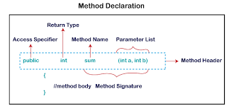
USER-DEFINED METHOD
The method written by the user or programmer is known as a user-defined method
We can modify the method according to our requirement.

Slide 152
Access Specifier:
Access specifier or modifier is the access type of the method. It specifies the visibility of the method. Java provides four types of access specifier:
Public: The method is accessible by all classes when we use public specifier in our application.
Private: When we use a private access specifier, the method is accessible only in the classes in which it is defined.
Protected: When we use protected access specifier, the method is accessible within the same package or subclasses in a different package.
Default: When we do not use any access specifier in the method declaration, Java uses default access specifier by default. It is visible only from the same package only.

Slide 153
Return Type:
Return type is a data type that the method returns.
If the method does not return anything, we use void keyword.
Method Name:
It is a unique name that is used to define the name of a method.
A method is invoked by its name.
Parameter List:
It is the list of parameters separated by a comma and enclosed in the pair of parentheses. It contains the data type and variable name. If the method has no parameter, left the parentheses blank.
Method Body: It is a part of the method declaration. It contains all the actions to be performed. It is enclosed within the pair of curly braces.

Slide 154
class Example
{
public static void main(String[] args)
{
int a = 15;
int b = 5;
Example e=new Example();
int c = e.minNumber(a, b);
System.out.println("Minimum Value = " + c);
}
public int minNumber(int n1, int n2)
{
int min;
if (n1 > n2)
min = n2;
else
min = n1;
return min;
}
}

Slide 155
OBJECT ORIENTED PROGRAMMING
Lecture #17: Constructors

Slide 156
CONSTRUCTORS
A constructor initializes an object when it is created.
we use a constructor to give initial values to the instance variables defined by the class, or to perform any other start-up procedures
It has the same name as the class in which it resides.
It is syntactically similar to a method
At the time of calling constructor, memory for the object is allocated in the memory.
Every time an object is created using the new() keyword, at least one constructor is called.
It calls a default constructor if there is no constructor available in the class. In such case, Java compiler provides a default constructor by default(initializes all member variables to zero)
Once we define our own constructor, the default constructor is no longer used.

Slide 157
CONSTRUCTORS
Rules for creating Java constructor
Constructor name must be the same as its class name
A Constructor must have no explicit return type
A Java constructor cannot be abstract, static, final, and synchronized
There are two types of constructors in Java:
No-arguments constructor
Parameterized constructor
Syntax:
class ClassName
{
ClassName()
{
}
}

Slide 158
NO-ARGUMENTS CONSTRUCTOR
No argument constructors of Java does not accept any parameters.
Instance variables of a method will be initialized with fixed values for all objects.
Syntax:
class ClassName {
ClassName()
{
var_name=value;
}
}
Example:
Public class MyClass
{
Int num;
MyClass()
{
num = 10;
}
}
class Example
{
public static void main(String args[])
{
MyClass o1 = new MyClass();
MyClass o2 = new MyClass();
System.out.println(o1.num + " " + o2.num);
}
}
Output:
10 10

Slide 159
PARAMETERIZED CONSTRUCTOR
The parameterized constructor is used to provide different values to distinct objects. However, you can provide the same values also.
Accepts one or more parameters
Parameters are added to a constructor in the same way that they are added to a method
Example:
class MyClass
{
int x;
MyClass(int i )
{
x = i;
}
}
class Example
{
public static void main(String args[])
{
MyClass o1 = new MyClass(10);
MyClass o2 = new MyClass(20);
System.out.println(o1.num + " " + o2.num);
}
}
Syntax:
class ClassName {
ClassName(parameters )
{
var_name=value;
}
}
Output: 10 20

Slide 160
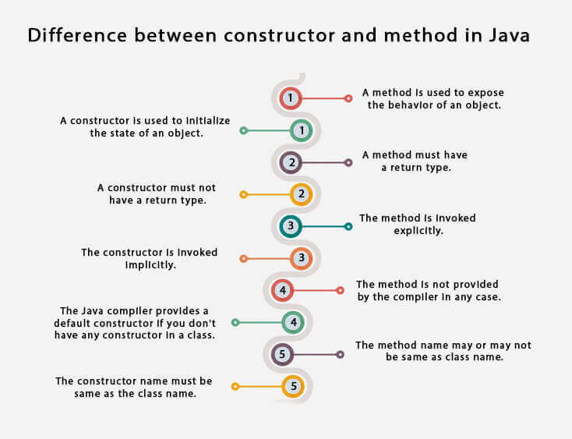
CONSTRUCTORS VS METHODS

Slide 161
OBJECT ORIENTED PROGRAMMING
Lecture #18: Constructor Overloading

Slide 162
CONSTRUCTOR OVERLOADING
It is a technique of having more than one constructor with different parameter lists.
Each constructor performs a different task.
They are differentiated by the compiler by the number of parameters in the list and their types.

Slide 163
class Student{
int id;
String name;
int age;
Student(int i,String n)
{
id = i;
name = n;
}
Student(int i,String n,int a)
{
id = i;
name = n;
age=a;
}
void display(){System.out.println(id+" "+name+" "+age);}
public static void main(String args[]){
Student s1 = new Student(11,"Jyothi");
Student s2 = new Student(22,"Rama",25);
s1.display();
s2.display();
}
}
Output:
11 jyothi 0
22 Rama 25

Slide 164
OBJECT ORIENTED PROGRAMMING
Lecture #19: Method Overloading

Slide 165
METHOD OVERLOADING
polymorphism means many forms.
Method overloading is one of the ways through which java supports polymorphism.
Polymorphism in Java is a concept by which we can perform a single action in different ways.
There are two types of polymorphism in Java: compile-time polymorphism and runtime polymorphism. We can perform polymorphism in java by method overloading and method overriding.
Compile Time Polymorphism: At compile-time, java knows which method to call by checking the method signatures. So this is called compile-time polymorphism or static or early binding. Compile-time polymorphism is achieved through method overloading.

Slide 166
METHOD OVERLOADING
Method Overloading is a technique which allows declaring multiple methods with same name but different parameters in the same class.
They are differentiated by the compiler by changing number of arguments or by changing the data type of arguments.
If two or more method have same name and same parameter list but differs in return type can not be overloaded.
There are two different ways of method overloading.
Different datatype of arguments
Different number of arguments

Slide 167
METHOD OVERLOADING BY CHANGING DATA TYPE OF ARGUMENTS.
You can see that sum() method is overloaded two times. The first takes two integer arguments, the second takes two float arguments.
class Calculate
{
void sum (int a, int b)
{
System.out.println("sum is"+(a+b)) ;
}
void sum (float a, float b)
{
System.out.println("sum is"+(a+b));
}
Public static void main (String[] args)
{
Calculate cal = new Calculate();
cal.sum (8,5); //sum(int a, int b) is method is called.
cal.sum (4.6f, 3.8f); //sum(float a, float b) is called.
}
}

Slide 168
METHOD OVERLOADING BY CHANGING NO. OF ARGUMENT
class Demo
{
void multiply(int l, int b)
{
System.out.println("Result is"+(l*b)) ;
}
void multiply(int l, int b,int h)
{
System.out.println("Result is"+(l*b*h));
}
public static void main(String[] args)
{
Demo a = new Demo();
a.multiply(8,5); //multiply(int l, int b) is method is called
a.multiply(4,6,2); //multiply(int l, int b,int h) is called
}
}
multiply() method is overloaded twice. The first method takes two arguments and the second method takes three arguments.

Slide 169
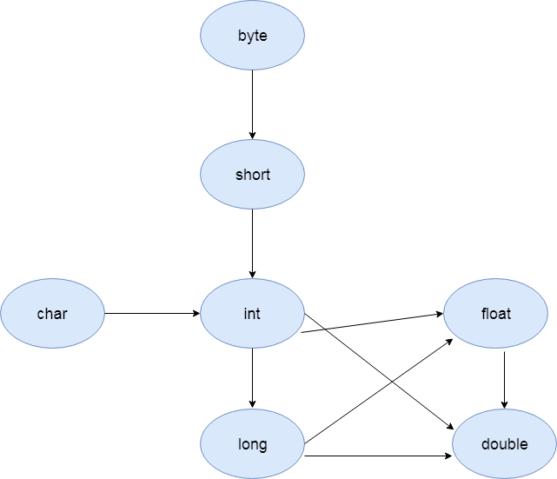
METHOD OVERLOADING AND TYPE PROMOTION
One type is promoted to another implicitly if no matching datatype is found.

Slide 170
METHOD OVERLOADING AND TYPE PROMOTION
class Example
{
void sum(int a,long b)
{
System.out.println(a+b);
}
void sum(int a,int b,int c)
{
System.out.println(a+b+c);
}
public static void main(String args[])
{
Example obj=new Example();
obj.sum(20,20);//now second int literal will be promoted to long
obj.sum(20,20,20);
}
}
Output:40
60

Slide 171
METHOD OVERLOADING AND TYPE PROMOTION
class Example
{
void sum(int a,int b)
{
System.out.println(a+b);
}
void sum(long a,long b)
{
System.out.println(a+b);
}
public static void main(String args[])
{
Example obj=new Example();
obj.sum(20,20);//now int arg sum() method gets invoked
}
}
Output:20
20

Slide 172
METHOD OVERLOADING AND TYPE PROMOTION
class Example
{
void sum(int a,long b)
{
System.out.println("a method invoked");
}
void sum(long a,int b)
{
System.out.println("b method invoked");
}
public static void main(String args[])
{
Example obj=new Example();
obj.sum(20,20);//now ambiguity
}
}
Output: Compile Time Error

Slide 173
OBJECT ORIENTED PROGRAMMING
Lecture #20: “this” Keyword

Slide 174
THIS KEYWORD
refers to “this” object (object in which it is used)
usage:
with an instance variable or method of “this” class
as a function inside a constructor of “this” class
as “this” object, when passed as parameter
refers to “this” object’s data member
class Weight {
int lb; int oz;
public Weight (int lb, int oz ) {
this.lb = lb; this.oz = oz;
}
}

Slide 175
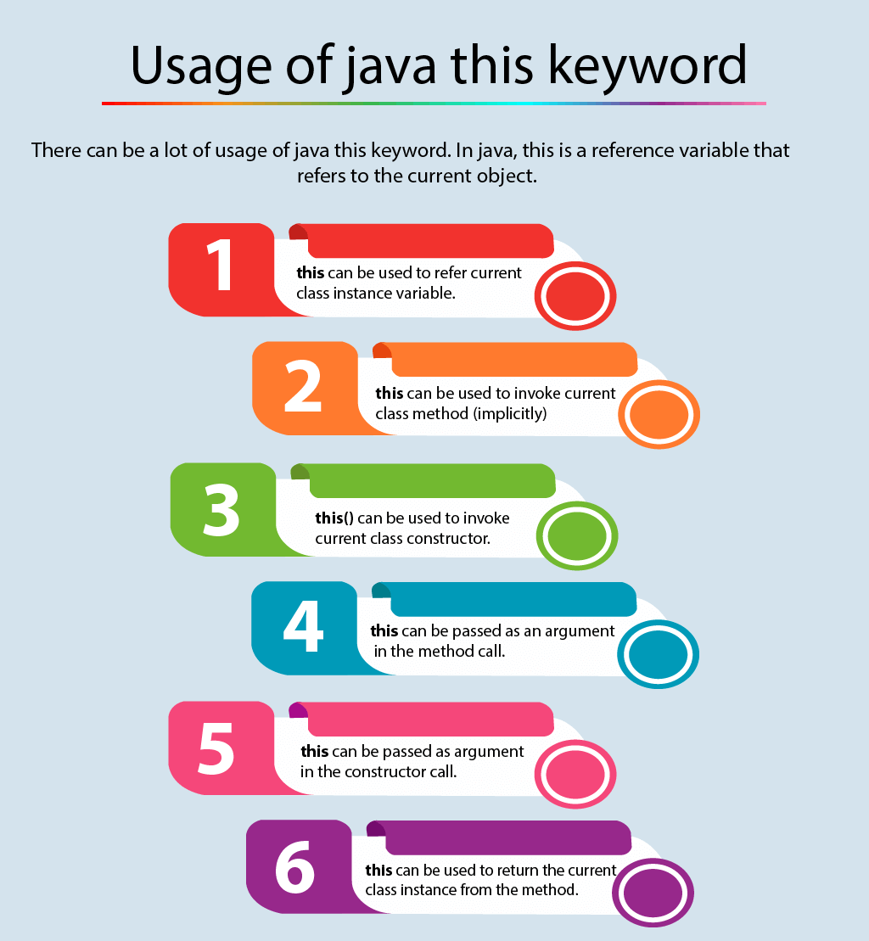

Slide 176
USAGE OF THIS KEYWORD
This can be used to refer current class instance variable
This can be used to refer current class method(implicitly)
This() can be used to invoke current class constructor.
The this keyword can be used o refer current class instance variable. If there is ambiguity between the instance variable and parameters, this keyword resolves the problem of ambiguity.

Slide 177
UNDERSTANDING THE PROBLEM WITHOUT THIS KEYWORD
class Student{
int rollno;
String name;
float fee;
Student(int rollno,String name,float fee){
rollno=rollno;
name=name;
fee=fee;
}
void display(){System.out.println(rollno+" "+name+" "+fee);}
}
class TestThis1{
public static void main(String args[]){
Student s1=new Student(111,"ankit",5000f);
Student s2=new Student(112,"sumit",6000f);
s1.display();
s2.display(); }}
Here, parameters (formal arguments) and instance variables are same. So, we are using this keyword to distinguish local variable and instance variable.
Output:
0 null 0.0
0 null 0.0

Slide 178
SOLUTION OF THE ABOVE PROBLEM BY THIS KEYWORD
class Student{
int rollno;
String name;
float fee;
Student(int rollno,String name,float fee){
this.rollno=rollno;
this.name=name;
this.fee=fee;
}
void display(){System.out.println(rollno+" "+name+" "+fee);}
}
class TestThis2{
public static void main(String args[]){
Student s1=new Student(111,"ankit",5000f);
Student s2=new Student(112,"sumit",6000f);
s1.display();
s2.display(); }}
If local variables(formal arguments) and instance variables are different, there is no need to use this keyword
Output:
111 ankit 5000
112 sumit 6000

Slide 179
PROGRAM WHERE THIS KEYWORD IS NOT REQUIRED
class Student{
int rollno;
String name;
float fee;
Student(int r,String n,float f){
rollno=r;
name=n;
fee=f;
}
void display(){System.out.println(rollno+" "+name+" "+fee);}
}
class TestThis3{
public static void main(String args[]){
Student s1=new Student(111,"ankit",5000f);
Student s2=new Student(112,"sumit",6000f);
s1.display();
s2.display(); }}
Output:
111 ankit 5000
112 sumit 6000

Slide 180
THIS: TO INVOKE CURRENT CLASS METHOD
You may invoke the method of the current class by using the this keyword.
If you don't use the this keyword, compiler automatically adds this keyword while invoking the method.

Slide 181
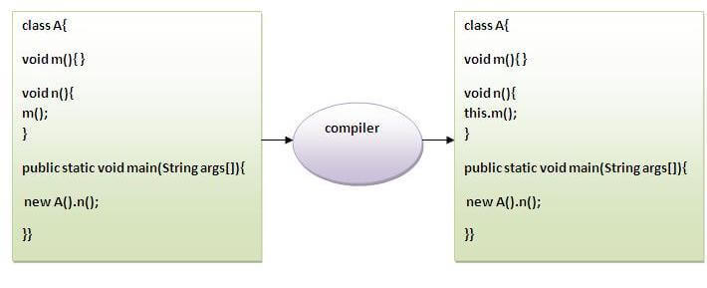
EXAMPLE

Slide 182
EXAMPLE
class A
{
void m()
{
System.out.println("hello m");
}
void n()
{
System.out.println("hello n");
this.m();
}
}
class TestThis4{
public static void main(String args[]){
A a=new A();
a.n();
}}
Output:
hello n
hello m

Slide 183
THIS() : TO INVOKE CURRENT CLASS CONSTRUCTOR
The this() constructor call can be used to invoke the current class constructor. It is used to reuse the constructor. In other words, it is used for constructor chaining.

Slide 184
CALLING DEFAULT CONSTRUCTOR FROM PARAMETERIZED CONSTRUCTOR:
class A
{
A()
{
System.out.println("hello a");
}
A(int x)
{
this();
System.out.println(x);
}
}
class TestThis5
{
public static void main(String args[])
{
A a=new A(10);
}
}
Default constructor
Output:
hello a
10

Slide 185
CALLING PARAMETERIZED CONSTRUCTOR FROM DEFAULT CONSTRUCTOR:
class A{
A()
{
this(5);
System.out.println("hello a");
}
A(int x)
{
System.out.println(x);
}
}
class TestThis6{
public static void main(String args[]){
A a=new A();
}} Output:
5
hello a
Parameterized constructor

Slide 186
EXAMPLE
class Student
{
int rollno;
String name,course;
float fee;
Student(int rollno,String name,String course)
{
this.rollno=rollno;
this.name=name;
this.course=course;
}
Student(int rollno,String name,String course,float fee)
{
this(rollno,name,course);//reusing constructor
this.fee=fee;
}
void display(){System.out.println(rollno+" "+name+" "+course+" "+fee);}
}
class TestThis7{
public static void main(String args[]){
Student s1=new Student(111,"ankit","java");
Student s2=new Student(112,"sumit","java",6000f);
s1.display();
s2.display();
}
}
Output:
111 ankit java null
112 sumit java 6000

Slide 187
OBJECT ORIENTED PROGRAMMING
Lecture #21: “static” Keyword

Slide 188
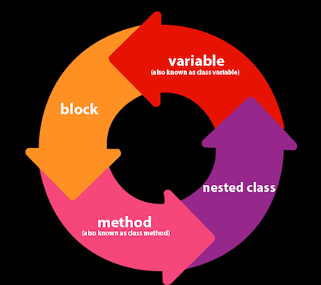
“STATIC” KEYWORD
The static keyword in Java is used for memory management mainly.
The static keyword belongs to the class than an instance of the class.
The “static” Keyword can be applied to:
Variable (also known as a instance variable)
Block
Method
Nested class

Slide 189
TO VARIBALE
Java static variable:
If you declare any variable as static, it is known as a static variable.
The static variable can be used to refer to the common property of all objects (which is not unique for each object)
for example: college name of students
The static variable gets memory only once in the class area at the time of class loading
It makes your program memory efficient (i.e., it saves memory).
Syntax:
static varibale_name=value;

Slide 190
TO VARIBALE
class Student{
int rollno;
String name;
String college=“GVPCOE";
}
If we make college filed static, this field will get the memory only once.
class Student{
int rollno;
String name;
static String college=“GVPCOE";
}
Java static property is shared to all objects.

Slide 191
TO VARIBALE
class Student{
int rollno;
String name;
static String college ="GVPCOE";//static variable
Student(int r, String n){
rollno = r;
name = n;
}
void display (){System.out.println(rollno+" "+name+" "+college);}
}
public class TestStaticVariable1{
public static void main(String args[]){
Student s1 = new Student(111,"AKHILA");
Student s2 = new Student(222,"PRAGADA");
s1.display();
s2.display();
}
}
Output:
111 AKHILA GVPCOE
222 PRAGADA GVPCOE

Slide 192
TO VARIBALE
class Counter{
int count=0;//will get memory each time when the instance is created
Counter(){
count++;//incrementing value
System.out.println(count);
}
public static void main(String args[]){
//Creating objects
Counter c1=new Counter();
Counter c2=new Counter();
Counter c3=new Counter();
}
}
Output:
1
1
1

Slide 193
TO VARIBALE
will get memory only once and retain its value
class Counter2{
static int count=0;
Counter2(){
count++;//incrementing the value of static variable
System.out.println(count);
}
public static void main(String args[]){
//creating objects
Counter2 c1=new Counter2();
Counter2 c2=new Counter2();
Counter2 c3=new Counter2();
}
}
Output:
1
2
3

Slide 194
TO BLOCK
A static block is used for initializing static variables.
The static block is executed once when the first object of the class is created.
Syntax:
static
{
//code
}

Slide 195
TO BLOCK
class Example {
static int a;
static int b;
static {
a = 10;
b = 2 * a;
}
public static void main( String args[] )
{
Example e = new Example();
System.out.printf("a = %d\t b = %d ", e.a, e.b);
}
}
Output:
a = 10 b = 20

Slide 196
OBJECT ORIENTED PROGRAMMING
Lecture #22: “static” Keyword(cont.)

Slide 197
“STATIC” KEYWORD
The static keyword in Java is used for memory management mainly.
The static keyword belongs to the class than an instance of the class.
The “static” Keyword can be applied to:
Variable (also known as a instance variable)
Block
Method
Nested class

Slide 198
TO METHOD
If you apply static keyword with any method, it is known as static method.
A static method belongs to the class rather than the object of a class.
A static method can be invoked without the need for creating an instance of a class.
A static method can access static data member and can change the value of it.
class Student{
int rollno;
String name;
static String college = “GVP";
//static method to change the value of static variable
static void change(){
college = “GVPCOE";
}

Slide 199
TO METHOD
class Calculate{
static int cube(int x){
return x*x*x;
}
public static void main(String args[])
{
int result=Calculate.cube(5);
System.out.println(result);
}
}
Output:
125

Slide 200
TO METHOD
Restrictions for the static method
The static method can not use non static data member or call non-static method directly.
this and super cannot be used in static context.
Java main method is static? because the object is not required to call a static method. If it were a non-static method, JVM creates an object first then call main() method that will lead the problem of extra memory allocation.
class A{
int a=40;//non static
public static void main(String args[]){
System.out.println(a);
}
}
Output:
Compile Time Error

Slide 201
JAVA MAIN METHOD IS STATIC?
Java main() method is always static, so that compiler can call it without the creation of an object or before the creation of an object of the class.
In any Java program, the main() method is the starting point from where compiler starts program execution. So, the compiler needs to call the main() method.
If the main() is allowed to be non-static, then while calling the main() method JVM has to instantiate its class.
While instantiating it has to call the constructor of that class, There will be ambiguity if the constructor of that class takes an argument.
Static method of a class can be called by using the class name only without creating an object of a class.
The main() method in Java must be declared public, static and void. If any of these are missing, the Java program will compile but a runtime error will be thrown.

Slide 202
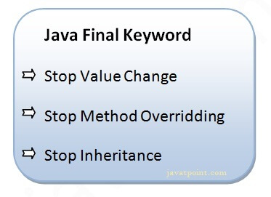
FINAL KEYWORD
The final keyword is a non access modifier used for classes , attributes and methods, which makes them non changeable.
(impossible to inherit or override)
The final keyword is useful when you want a variable to always store the same value like PI(3.14)
The final key word is a modifier.

Slide 203
FINAL KEYWORD
The final keyword in java is used to restrict the user. The java final keyword can be used in many contexts.
Variable
Method
Class
It can be applied with the variables , a final variable that have no value it is called blank final variable or uninitialized variable .
It can be initialized in the constructor only.
The blank final variable can be static also which will be initialized in the static block only.

Slide 204
FINAL VARIABLE
If you make any variable as final, you cannot change the value of final variable (it will be constant)
Ex: there is a final variable speed limit, we are going to change the value of this variable.
But, it cannot be changed because final variable once assigned a value can never be changed.

Slide 205
EXAMPLE
class Bike
{
final int speedlimit=90;
void run()
{
speedlimit=400;
}
public static void main(String args[])
{
Bike obj= new Bike();
obj.run();
}
}
Output:
Compile time error

Slide 206
FINAL METHOD
class Bike
{
final void run()
{
System.out.println("running");
}
class Honda extends Bike
{
void run()
{
System.out.println("running safely with 100 kmph");
}
public static void main(String args[])
{
Honda honda = new Honda();
honda.run();
}
}
}
Output: Compile time error

Slide 207
IS FINAL METHOD INHERITED?
Class Bike
{
final void run()
{
System.out.println(“running…”);
}
Class Honda2 extends Bike
{
public static void main(String args[])
{
New Honda2().run();
}
}
Output: running…

Slide 208
WHAT IS BLANK OR UNINITIALIZED FINAL VARIABLE?
A final variable that is not initialized at the time of declaration is known as blank final variable.
If you want to create a variable that is initialized at the time of creating object and once initialized may not be changed, it is useful.
For example, PAN CARD number of an employee.
It can be initialized only in constructor.
Ex: class Student
{
int id;
String name;
final String PAN_CARD_NUMBER;
}

Slide 209
CAN WE INITIALIZE BLANK FINAL VARIABLE?
Yes, but only in constructors
class Bike10{
final int speedlimit;//blank final variable
Bike10(){
speedlimit=70;
System.out.println(speedlimit);
}
public static void main(String args[]){
new Bike10();
}
}
Output: 70

Slide 210
GARBAGE COLLECTION
Java garbage collection is the process by which Java programs perform automatic memory management.
Java programs compile to bytecode that can be run on a Java Virtual Machine, or JVM for short.
When Java programs run on the JVM, objects are created on the heap, which is a portion of memory dedicated to the program.
Eventually, some objects will no longer be needed.
The garbage collector finds these unused objects and deletes them to free up memory.

Slide 211
GARBAGE COLLECTION
In java, garbage means unreferenced objects.
Garbage Collection is process of reclaiming the runtime unused memory automatically. In other words, it is a way to destroy the unused objects.
To do so, we were using free() function in C language and delete() in C++. But, in java it is performed automatically. So, java provides better memory management.
Advantage of Garbage Collection
It makes java memory efficient because garbage collector removes the unreferenced objects from heap memory.
It is automatically done by the garbage collector(a part of JVM) so we don't need to make extra efforts.

Slide 212
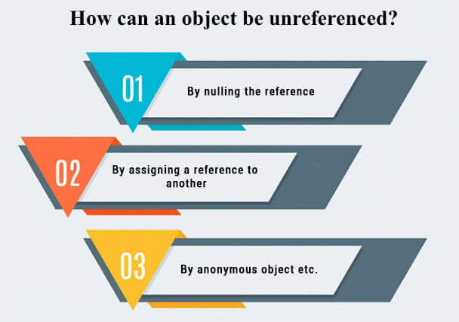

Slide 213
By nulling a reference:
Employee e= new Employee();
e=null;
By assigning a reference to another:
Employee e1= new Employee();
Employee e2= new Employee();
e1=e2;
//now the first object is referred by e1 is available for garbage collection
By anonymous object:
new Employee();

Slide 214
HOW IT WORKS?
Java garbage collection is an automatic process.
The programmer does not need to explicitly mark objects to be deleted.
The garbage collection implementation lives in the JVM.
Each JVM can implement garbage collection however it pleases; the only requirement is that it meets the JVM specification.
Although there are many JVMs, Oracle’s HotSpot is by far the most common. It offers a robust and mature set of garbage collection options.
While HotSpot has multiple garbage collectors that are optimized for various use cases, all its garbage collectors follow the same basic process.

Slide 215
CONTD…
In the first step, unreferenced objects are identified and marked as ready for garbage collection.
In the second step, marked objects are deleted.
Optionally, memory can be compacted after the garbage collector deletes objects, so remaining objects are in a contiguous block at the start of the heap.
The compaction process makes it easier to allocate memory to new objects sequentially after the block of memory allocated to existing objects.
All of HotSpot’s garbage collectors implement a generational garbage collection strategy that categorizes objects by age.
The rationale behind generational garbage collection is that most objects are short-lived and will be ready for garbage collection soon after creation.

Slide 216
FINALIZE() METHOD
The java.lang.Object.finalize() is called by the garbage collector on an object when garbage collection determines that there are no more references to the object. A subclass overrides the finalize method to dispose of system resources or to perform other cleanup.
Declaration
Following is the declaration for java.lang.Object.finalize() method
protected void finalize()
Parameters
NA
Return Value
This method does not return a value.
Exception
Throwable − the Exception raised by this method

Slide 217
EXAMPLE
The following example shows the usage of lang.Object.finalize() method.
import java.util.*;
public class ObjectDemo extends GregorianCalendar {
public static void main(String[] args) {
try {
ObjectDemo cal = new ObjectDemo();
System.out.println("" + cal.getTime());
System.out.println("Finalizing...");
cal.finalize();
System.out.println("Finalized."); }
catch (Throwable ex) {
ex.printStackTrace(); }
}
}
Output:
Sat Sep 22 00:27:21 EEST 2012
Finalizing...
Finalized.

Slide 218
OBJECT ORIENTED PROGRAMMING
Lecture #23: Inheritance-Introduction

Slide 219
INHERITANCE
Inheritance can be defined as the process where one class acquires the properties (methods and fields) of another.
Reusability is achieved by INHERITANCE
Java classes Can be Reused by extending a class. Extending an existing class is nothing but reusing properties of the existing classes.
The class whose properties are extended is known as super or base or parent class.
The class which extends the properties of super class is known as sub or derived or child class
A class can either extends another class or can implement an interface

Slide 220
DEFINING A SUBCLASS
Syntax :
class <subclass name> extends <superclass name>
{
variable declarations;
method declarations;
}
extends keyword signifies that properties of the super class are extended to sub class
Sub class will not inherit private members of super class

Slide 221
INHERITANCE
class B extends A { ….. }
A super class
B sub class
A
<<class>>
B
<<class>>
A
<<interface>>
class B implements A { ….. }
A interface
B sub class
B
<<class>>

Slide 222
TYPES OF INHERITANCE
Single Inheritance
Hierarchical Inheritance
A
A
X
X
B
B
A
B
C
A
B
C
NOT SUPPORTED BY JAVA
MultiLevel Inheritance
Multiple Inheritance
SUPPORTED BY JAVA
A
A
A
B
A
B
B
B
C
C
C
C

Slide 223
TYPES OF INHERITANCE
Mulitiple Inheritance can be implemented by implementing multiple interfaces not by extending multiple classes
Example :
class Z extends A implements C , D
{ …………}
OK
class Z extends A ,B class Z extends A extends B
{ {
OR
} }
A
C
D
Z
WRONG
WRONG

Slide 224
OBJECT ORIENTED PROGRAMMING
Lecture #24: Single Inheritance

Slide 225
INHERITANCE
Inheritance can be defined as the process where one class acquires the properties (methods and fields) of another.
Reusability is achieved by INHERITANCE
Java classes Can be Reused by extending a class. Extending an existing class is nothing but reusing properties of the existing classes.
The class whose properties are extended is known as super or base or parent class.
The class which extends the properties of super class is known as sub or derived or child class
A class can either extends another class or can implement an interface

Slide 226
TYPES OF INHERITANCE
Single Inheritance
A
A
B
B

Slide 227
SINGLE INHERITANCE
class A
{
int i,j;
void showij()
{
System.out.println(“i and j : “+i+j);
}
}
class B extends A
{
int k;
void showk()
{
System.out.println(“k : “+k);
}
void sum()
{
System.out.println(“i+j+k: “+(i+j+k));
}
}
class Example
{
public static void main(String args[])
{
A a = new A();
B b = new B();
a.i=10;
a.j=20;
System.out.println(“contents of a:”);
a.showij();
b.i=1;
b.j=2;
b.k=3;
System.out.println(“contents of b:”);
b.showij();
b.showk();
System.out.println(“sum of i,j,k of b:”);
b.sum();
}
}
Output:
1
1
1

Slide 228
OBJECT ORIENTED PROGRAMMING
Lecture #25: Multilevel Inheritance

Slide 229
INHERITANCE
Inheritance can be defined as the process where one class acquires the properties (methods and fields) of another.
Reusability is achieved by INHERITANCE
Java classes Can be Reused by extending a class. Extending an existing class is nothing but reusing properties of the existing classes.
The class whose properties are extended is known as super or base or parent class.
The class which extends the properties of super class is known as sub or derived or child class
A class can either extends another class or can implement an interface

Slide 230
TYPES OF INHERITANCE
MultiLevel Inheritance
A
A
B
B
C
C

Slide 231
MULTI LVEL INHERITANCE
class C extends B
{
int k;
void showk()
{
System.out.println(“k : “+k);
}
void sum()
{
System.out.println(“i+j+k: “+(i+j+k));
}
}
class Example
{
public static void main(String args[]) {
C c=new C();
c.i=10;
c.j=20;
c.k=30;
c.sum()
}}
class A
{
int i;
void showij()
{
System.out.println(“i :”+i);
}
}
class B extends A
{
int j;
void showj()
{
System.out.println(“j : “+j);
}
}
Output:
1
1
1

Slide 232
OBJECT ORIENTED PROGRAMMING
Lecture #26: Hierarchical Inheritance

Slide 233
INHERITANCE
Inheritance can be defined as the process where one class acquires the properties (methods and fields) of another.
Reusability is achieved by INHERITANCE
Java classes Can be Reused by extending a class. Extending an existing class is nothing but reusing properties of the existing classes.
The class whose properties are extended is known as super or base or parent class.
The class which extends the properties of super class is known as sub or derived or child class
A class can either extends another class or can implement an interface

Slide 234
TYPES OF INHERITANCE
Hierarchical Inheritance
X
X
A
B
C
A
B
C

Slide 235
HIERARCHICAL INHERITANCE
class A
{
int i;
void showij()
{
System.out.println(“i :”+i);
}
}
class B extends A
{
int j;
void showj()
{
System.out.println(“j : “+j);
}
void sum()
{
System.out.println(“i+j: “+(i+j));
}
}
class C extends A{
int k;
void showk()
{
System.out.println(“k : “+k);
}
void sum()
{
System.out.println(“i+k: “+(i+k));
}
}
class Example
{
public static void main(String args[]) {
C c=new C();
c.i=10;
c.k=30;
c.sum()
}}
Output:
1
1
1

Slide 236
OBJECT ORIENTED PROGRAMMING
Lecture #27: “super” keyword

Slide 237
SUPER KEYWORD
The super keyword in Java is used in subclasses to access superclass members (attributes, constructors and methods).
Can be used to call super class constrctor
1. super()
2. super(<parameter-list>)
Can refer to super class instance variables/Methods
3. super . <super class instance variable/Method>

Slide 238
USE OF SUPER KEYWORD FOR CONSTRUCTORS
Whenever a sub class object is created ,super class constructor is called first.
If super class constructor does not have any constructor of its own OR has an unparametrized constructor then it is automatically called by Java Run Time by using call super()
If a super class has a parameterized constructor then it is the responsibility of the sub class constructor to call the super class constructor by call
super(<parameters required by super class>)
Call to super class constructor must be the first statement in sub class constructor

Slide 239
1. WHEN SUPER CLASS HAS A UNPARAMETRIZED CONSTRUCTOR
class A
{
A()
{
System.out.println("This is constructor
of class A");
}
} // End of class A
class B extends A
{
B()
{
super();
System.out.println("This is constructor of class B”);}
} // End of class B
class inhtest
{
public static void main(String args[])
{
B b1 = new B();
}
}
Optional
OUTPUT
This is constructor of class A
This is constructor of class B

Slide 240
class A
{
A()
{
System.out.println("This is class A");
}
}
class B extends A
{
B()
{
System.out.println("This is class B");
}
}
class inherit1
{
public static void main(String args[])
{
B b1 = new B();
}
}
File Name is inherit1.java
Output:
This is class A
This is class B
1. When super class has a Unparametrized constructor

Slide 241
1. When super class has a Unparametrized constructor
class A
{
private A()
{
System.out.println("This is class A");
}
}
class B extends A
{
B()
{
System.out.println("This is class B");
}
}
class inherit2
{
public static void main(String args[])
{
B b1 = new B();
}
}
Output:
Error: A() has private access in A

Slide 242
class A
{
private A()
{
System.out.println("This is class A");
}
A()
{
System.out.println("This is class A");
}
}
class B extends A
{
B()
{
System.out.println("This is class B");
}
}
class inherit2
{
public static void main(String args[])
{
B b1 = new B();
} }
Output:
A() is already defined in A
A() has private access in A
2 errors
1. When super class has a Unparametrized constructor

Slide 243
2. When super class has a parametrized constructor
class A
{
int a;
A( int a1)
{
a =a1;
System.out.println("This is constructor of class A");
}
}
class B extends A
{
int b;
double c;
B(int b1,double c1)
{
b=b1;
c=c1;
System.out.println("This is constructor of class B");
}
}
B b1 = new B(10,8.6);
D:\java\bin>javac inhtest.java
inhtest.java:15: cannot find symbol
symbol : constructor A()
location: class A
{
^
1 errors

Slide 244
class A
{
int a;
A( int a1)
{
a =a1;
System.out.println("This is constructor of class A");
} }
class B extends A
{
int b;
double c;
B(int a2,int b1,double c1)
{
super(a2);
b=b1;
c=c1;
System.out.println("This is constructor of class B");
} }
2. When super class has a parametrized constructor
B b1 = new B(8,10,8.6);
OUTPUT
This is constructor of class A
This is constructor of class B

Slide 245
OBJECT ORIENTED PROGRAMMING
Lecture #28: “super” keyword

Slide 246
SUPER KEYWORD
The super keyword in Java is used in subclasses to access superclass members (attributes, constructors and methods).
Can be used to call super class constrctor
1. super()
2. super(<parameter-list>)
Can refer to super class instance variables/Methods
3. super . <super class instance variable/Method>

Slide 247
3. Refer to super class instance variables/Methods
class A
{
int a;
A( int a)
{
this.a =a;
System.out.println("This is constructor of class A");
}
void print()
{
System.out.println("a="+a);
}
void display()
{
System.out.println("hello This is Display in A");
}
} // End of class A
class B extends A
{
int b;
double c;
B(int a,int b,double c)
{
super(a);
this.b=b;
this.c=c;
System.out.println("This is constructor of class B");
}
void show()
{
print();
System.out.println("b="+b);
System.out.println("c="+c);
}
} // End of class B

Slide 248
3. Refer to super class instance variables/Methods
class inhtest1
{
public static void main(String args[])
{
B b1 = new B(10,8,4.5);
b1.show();
}
}
OutPut
D:\java\bin>java inhtest1
This is constructor of class A
This is constructor of class B
a=10
b=8
c=4.5

Slide 249
3. Refer to super class instance variables/Methods
class A
{
int a;
A( int a)
{
this.a =a;
System.out.println("This is constructor of class A");
}
void show()
{
System.out.println("a="+a);
}
void display()
{
System.out.println("hello This is Display in A");
}
}
class B extends A
{
int b;
private double c;
B(int a,int b,double c)
{
super(a);
this.b=b;
this.c=c;
System.out.println("This is constructor of class B");
}
void show()
{
super.show();
System.out.println("b="+b);
System.out.println("c="+c);
display();
}
}

Slide 250
3. Refer to super class instance variables/Methods
class inhtest1
{
public static void main(String args[])
{
B b1 = new B(10,8,4.5);
b1.show();
}
}
/* OutPut
D:\java\bin>java inhtest1
This is constructor of class A
This is constructor of class B
a=10
b=8
c=4.5
hello This is Display in A
*/

Slide 251
class A
{
int a;
A( int a)
{
this.a =a;
}
void show()
{
System.out.println("a="+a);
}
void display()
{
System.out.println("hello This is
Display in A");
}
}
class B extends A
{
int b;
double c;
B(int a,int b,double c)
{
super(a);
this.b=b;
this.c=c;
}
void show()
{
//super.show();
System.out.println("a="+a);
System.out.println("b="+b);
System.out.println("c="+c);
}
}
class inhtest2
{
public static void main(String
args[])
{
B b1 = new B(10,20,8.4);
b1.show();
}
}
D:\java\bin>java inhtest2
a=10
b=20
c=8.4
3. Refer to super class instance variables/Methods

Slide 252
class B extends A
{
// super class variable a hides here
int a;
int b;
double c;
B(int a,int b,double c)
{
super(100);
this.a = a;
this.b=b;
this.c=c;
}
void show()
{
System.out.println("Super class a="+super.a);
System.out.println("a="+a);
System.out.println("b="+b);
System.out.println("c="+c);
}
}
class A
{
int a;
A( int a)
{
this.a =a;
}
}
class inhtest2
{
public static void main(String args[])
{
B b1 = new B(10,20,8.4);
b1.show();
}
}
Out Put
D:\java\bin>java inhtest2
Super class a=100
a=10
b=20
c=8.4
3. Refer to super class instance variables/Methods

Slide 253
OBJECT ORIENTED PROGRAMMING
Lecture #29: Method Overriding

Slide 254
METHOD OVERRIDING
If subclass (child class) has the same method as declared in the parent class, it is known as method overriding in Java.
Uses:
Method overriding is used to provide the specific implementation of a method which is already provided by its superclass.
Method overriding is used for runtime polymorphism
Rules for Java Method Overriding
The method must have the same name as in the parent class
The method must have the same parameter as in the parent class.

Slide 255
METHOD OVERRIDING
class Vehicle
{
void run()
{
System.out.println("Vehicle is running");
}
}
class Vehicle
{
void run()
{
System.out.println("Vehicle is running");
}
}
class Bike extends Vehicle
{
public static void main(String args[])
{
Bike obj = new Bike();
obj.run();
}
}
class Bike extends Vehicle
{
public static void main(String args[])
{
Bike obj = new Bike();
obj.run();
}
void run()
{
System.out.println("Bike is running safely");
}
}
Output:
Vehicle is running
Output:
Bike is running safely

Slide 256
METHOD OVERRIDING
class Vehicle
{
void run()
{
System.out.println("Vehicle is running");
}
}
class Vehicle
{
void run()
{
System.out.println("Vehicle is running");
}
}
class Bike extends Vehicle
{
public static void main(String args[])
{
Bike obj = new Bike();
obj.run();
}
}
class Bike extends Vehicle
{
public static void main(String args[])
{
Bike obj = new Bike();
obj.run();
}
void run()
{
super.run();
System.out.println("Bike is running safely");
}
}
Output:
Vehicle is running
Output:
Vehicle is running
Bike is running safely

Slide 257
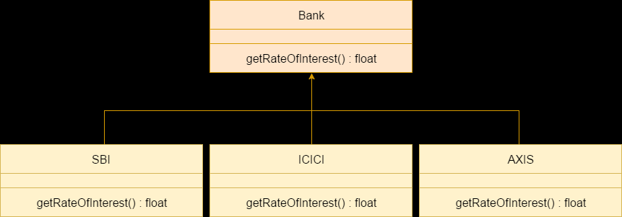
METHOD OVERRIDING REALTIME EXAMPLE
Example

Slide 258
METHOD OVERRIDING
Note:
A method declared as static method cannot be overridden
Main method cannot be overridden
A method declared final cannot be overridden.
Constructors cannot be overridden.

Slide 259




METHOD OVERLOADING VS METHOD OVERRIDING

Slide 260
OBJECT ORIENTED PROGRAMMING
Lecture #30: Dynamic Method Dispatch

Slide 261
DYNAMIC METHOD DISPATCH
Dynamic method dispatch is a mechanism by which a call to an overridden method is resolved at runtime.
This is how java implements runtime polymorphism.
When an overridden method is called by a reference, java determines which version of that method to execute based on the type of object it refer to.
In simple words the type of object which it referred determines which version of overridden method will be called.

Slide 262
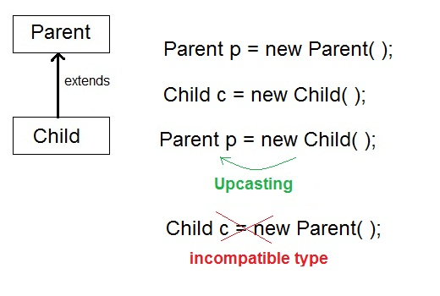

Slide 263
UPCASTING IN JAVA
When Parent class reference variable refers to Child class object, it is known as Upcasting.
In Java this can be done and is helpful in scenarios where multiple child classes extends one parent class.
In those cases we can create a parent class reference and assign child class objects to it.
Example:
Notice the last output. This is because of the statement, gm = ck;. Now gm.type() will call the Cricket class version of type() method. Because here gm refers to the cricket object.

Slide 264

EXAMPLE

Slide 265
EXAMPLE
class Game{
public void type(){
System.out.println("Indoor & outdoor"); }
}
Class Cricket extends Game
{
public void type(){
System.out.println("outdoor game");
}
public static void main(String[] args){
Game gm = new Game();
Cricket ck = new Cricket();
gm.type();
ck.type();
gm = ck; //gm refers to Cricket object
gm.type(); //calls Cricket's version of type}
}
Output:
Indoor & outdoor
Outdoor game
Outdoor game

Slide 266
DIFFERENCE BETWEEN STATIC BINDING AND DYNAMIC BINDING IN JAVA?
Static binding in Java occurs during compile time while dynamic binding occurs during runtime. Static binding uses type(Class) information for binding while dynamic binding uses instance of class(Object) to resolve calling of method at run-time. Overloaded methods are bonded using static binding while overridden methods are bonded using dynamic binding at runtime.
In simpler terms, Static binding means when the type of object which is invoking the method is determined at compile time by the compiler. While Dynamic binding means when the type of object which is invoking the method is determined at run time by the compiler.

Slide 267
OBJECT ORIENTED PROGRAMMING
Lecture #31: “final” keyword

Slide 268
“FINAL” KEYWORD
The final keyword in java is used to restrict the user
final can be:
variable
method
class

Slide 269
JAVA FINAL VARIABLE
If you make any variable as final, you cannot change the value of final variable(It will be constant).
class Bike
{
final int speedlimit=90;//final variable
void run()
{
speedlimit=400; // error
}
public static void main(String args[])
{
Bike obj=new Bike();
obj.run();
}
}//end of class
class FinalVariable
{
final int var = 50;
var = 60 // error
}
compile-time errors

Slide 270
JAVA FINAL METHOD
class Bike
{
final void run()
{
System.out.println("running");
}
}
class Honda extends Bike
{
void run()
{System.out.println("running safely with 100kmph");}
public static void main(String args[])
{
Honda honda= new Honda();
honda.run();
}
}
If you make any method as final, you cannot override it.
compile-time errors

Slide 271
JAVA FINAL CLASS
final class Bike
{
....
}
class Honda1 extends Bike
{
void run()
{
System.out.println("running safely with 100kmph");
}
public static void main(String args[])
{
Honda1 honda= new Honda1();
honda.run();
}
}
If you make any class as final, you cannot extend it.
compile-time errors

Slide 272
“FINAL” KEYWORD
uninitialized final variable:
A final variable that is not initialized at the time of declaration is known as blank final variable.
It can be initialized only in constructor.
Ex: PANCARD NUMBER
class Bike{
final int speedlimit;//blank final variable
Bike()
{
speedlimit=70;
System.out.println(speedlimit);
}
public static void main(String args[])
{
Bike b1=new Bike();
}
}

Slide 273
“FINAL” KEYWORD
static blank final variable
A static final variable that is not initialized at the time of declaration is known as static blank final variable.
It can be initialized only in static block.
class A
{
static final int data;//static blank final variable
static
{
data=50;
}
public static void main(String args[])
{
System.out.println(A.data);
}
}

Slide 274
“FINAL” KEYWORD
final parameter
If you declare any parameter as final, you cannot change the value of it.
class Bike
{
int cube(final int n)
{
n=n+2;//can't be changed as n is final
n*n*n;
}
public static void main(String args[])
{
Bike b=new Bike();
b.cube(5);
}
}
compile-time errors

Slide 275
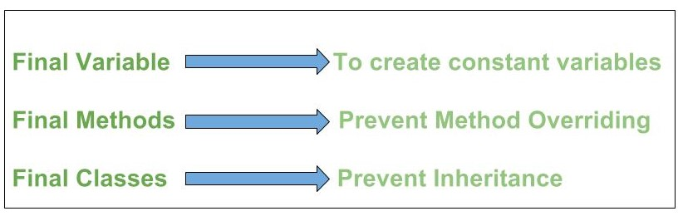
“FINAL” KEYWORD

Slide 276
OBJECT ORIENTED PROGRAMMING
Lecture #32: Abstract class

Slide 277
ABSTRACTION
Abstraction is a process of hiding the implementation details and showing only functionality to the user.
There are two ways to achieve abstraction in java
Abstract class
Interface

Slide 278
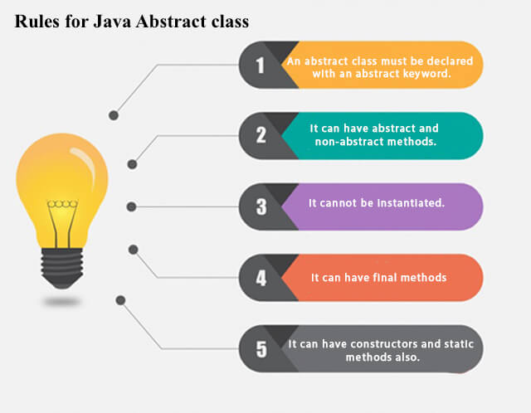
ABSTRACT CLASS
A class which contains the abstract keyword in its declaration is known as abstract class.

Slide 279
ABSTRACT CLASS
An abstract class can have both abstract and regular methods
The abstract keyword is a non-access modifier, used for classes and methods:
Abstract class: is a restricted class that cannot be used to create objects (to access it, it must be inherited from another class).
Abstract method: can only be used in an abstract class, and it does not have a body. The body is provided by the subclass (inherited from).
Syntax:
abstract class_name{ }
no method body
Syntax:
abstract type method_name(paramenter_list);

Slide 280
abstract class Figure
{
int dim1,dim2;
Figure(int d1, int d2)
{
dim1=d1;
dim2=d2;
}
void display()
{
System.out.println(“Area is: “);
}
abstract void area(); //abstract method
}
class Rectangle extends Figure
{
Rectangle(int a, int b)
{
super(a,b);
}
void area() //overriding abstract method
{
System.out.println(dim1*dim2);
}
}
class Example32{
public static void main(String args[])
{
Rectangle r=new rectangle(10,20);
Figure f;
f=r;
f.display();
f.area();
}
}
Any subclass of an abstract class must either implement all of the abstract methods of super class or be declared itself aabstract

Slide 281
OBJECT ORIENTED PROGRAMMING
Lecture #33: Interface

Slide 282
ABSTRACTION
Abstraction is a process of hiding the implementation details and showing only functionality to the user.
There are two ways to achieve abstraction in java
Abstract class
Interface

Slide 283
INTERFACE
An interface is a fully abstract class. It includes a group of abstract methods (methods without a body).
We use the “interface” keyword to create an interface in Java
Uses:
It is used to achieve abstraction.
By interface, we can support the functionality of multiple inheritance.
Syntax:
interface <interface_name>{
// declare constant fields
// declare methods that abstract
// by default.
}

Slide 284
INTERFACE
Implementing an Interface
Like abstract classes, we cannot create objects of interfaces.
To use an interface, other classes must implement it. We use the “implements” keyword to implement an interface.
Note:
It is similar to class. It is a collection of abstract methods.
Method bodies exist only for default methods and static methods.
An interface may also contain constants, default methods, static methods, and nested types.
all the methods of the interface need to be defined in the class.
cannot instantiate an interface.
does not contain any constructors.

Slide 285
interface Polygon
{
void getArea(int length, int breadth);
}
class Rectangle implements Polygon
{
public void getArea(int length, int breadth)
{
System.out.println("The area of the rectangle is " + (length * breadth));
}
}
class Example{
public static void main(String[] args) {
Rectangle r1 = new Rectangle();
r1.getArea(5, 6);
}
}
A class that implements an interface must implement all the methods declared in the interface.

Slide 286
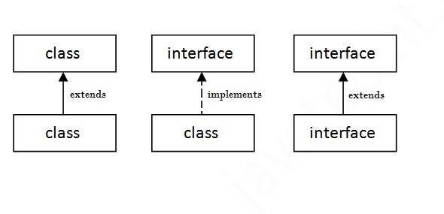
INTERFACE
The relationship between classes and interfaces

Slide 287
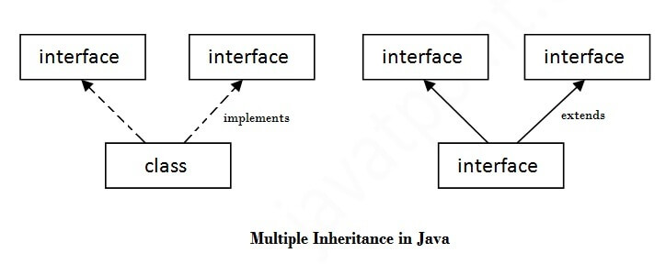
INTERFACE
Multiple inheritance in Java by interface

Slide 288
INTERFACE
if any class implements Polygon, it should provide implementations for all the abstract methods of both Line and Polygon.
Implementing Multiple Interfaces
Extending an Interface
interface A {
// members of A
}
interface B {
// members of B
}
class C implements A, B {
// abstract members of A
// abstract members of B
}
interface Line {
// members of Line interface
}
// extending interface
interface Polygon extends Line {
// members of Polygon interface
// members of Line interface
}

Slide 289
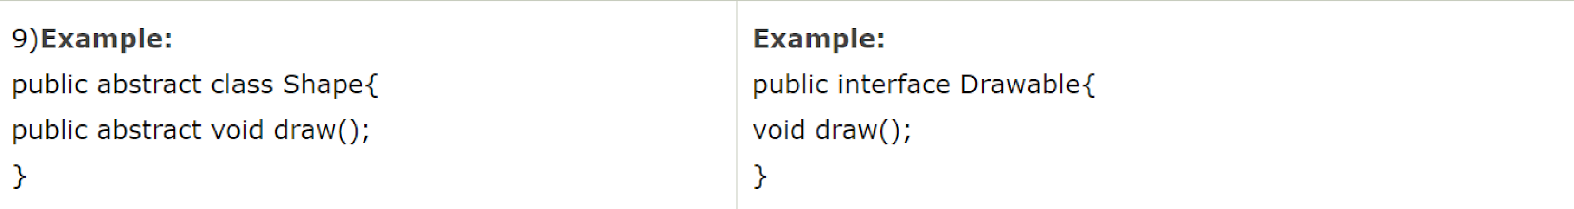

Slide 290
OBJECT ORIENTED PROGRAMMING
Lecture #35: Packages

Slide 291
PACKAGES
A Package can be defined as a grouping of related types (classes, interfaces, enumerations and annotations)
Packages are used for:
Preventing naming conflicts.
Making searching/locating and usage of classes, interfaces, enumerations easier
Providing controlled access
Packages can be considered as data encapsulation (or data-hiding).
Package names and directory structure are closely related.

Slide 292
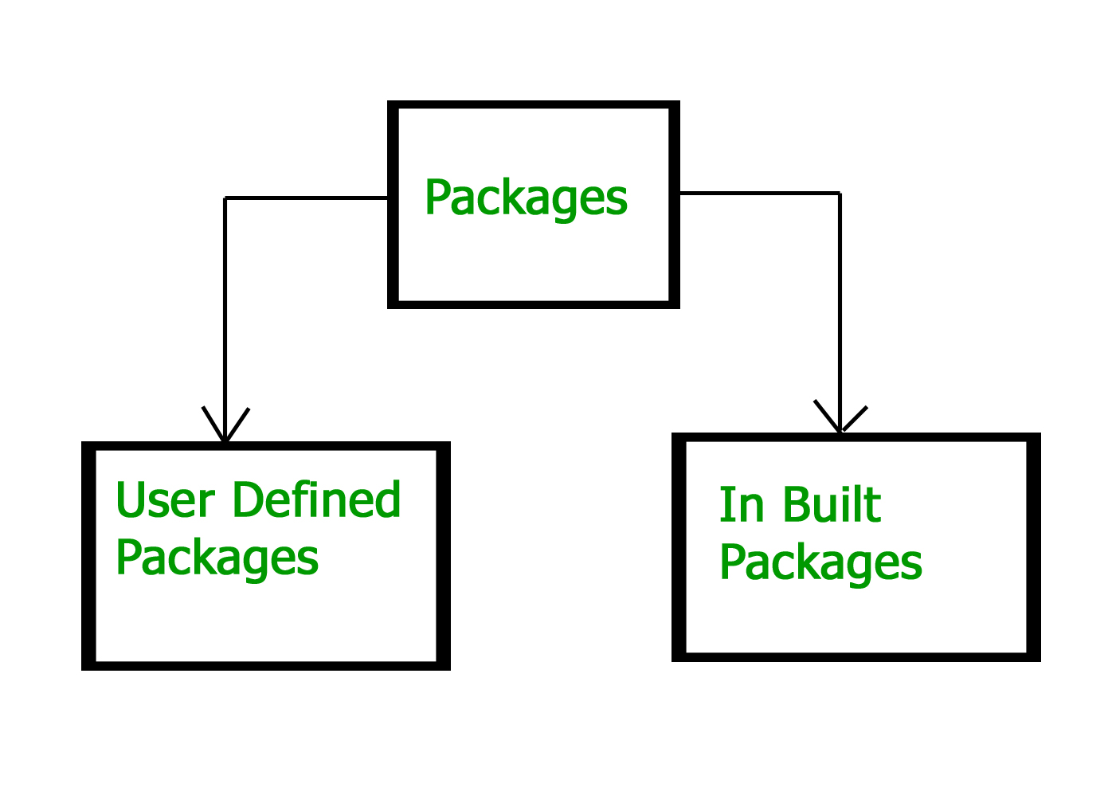
PACKAGES

Slide 293
BUILT-IN PACKAGES
These packages consist of a large number of classes which are a part of Java API.
java.lang: Contains language support classes(e.g classed which defines primitive data types, math operations). This package is automatically imported.
java.io: Contains classed for supporting input / output operations.
java.util: Contains utility classes which implement data structures like Linked List, Dictionary and support ; for Date / Time operations.
java.applet: Contains classes for creating Applets.
java.awt: Contain classes for implementing the components for graphical user interfaces (like button , ;menus etc).
java.net: Contain classes for supporting networking operations.

Slide 294
USER-DEFINED PACKAGES
It is a good practice to use names of packages with lower case letters to avoid any conflicts with the names of classes and interfaces.
These are the packages that are defined by the user.
Creating a Package:
choose a name for the package
include a “package” statement along with that name
The package statement should be the first line in the source file.
There can be only one package statement in each source file
Example:
package mypack;
public class Simple{
public static void main(String args[]){
System.out.println("Welcome to package");
}
}
Syntax:
package package_name;

Slide 295
USER-DEFINED PACKAGES
compile java package
run java package program
You need to use fully qualified name
Syntax:
javac -d directory javafilename
Example:
javac -d . Simple.java
The -d switch specifies the destination where to put the generated class file.
Example:
java mypack.Simple

Slide 296
ACCESS PACKAGE FROM ANOTHER PACKAGE
three ways to access
import package.*;
import package.classname;
fully qualified name.

Slide 297
ACCESS PACKAGE FROM ANOTHER PACKAGE
import package.*;
“import” keyword is used to make the classes and interface of another package accessible to the current package.
All the classes and interfaces of this package will be accessible but not subpackages.

Slide 298
save as: A.java
package pack;
public class A{
public void msg(){System.out.println("Hello");}
}
package mypack;
import pack.*;
class B{
public static void main(String args[]){
A obj = new A();
obj.msg();
}
}
save as: B.java
Output:
javac -d . A.java
javac -d . B.java
java mypack.B
Hello

Slide 299
ACCESS PACKAGE FROM ANOTHER PACKAGE
import package.classname;
“import” keyword is used to make the classes and interface of another package accessible to the current package.
only declared class of this package will be accessible.

Slide 300
save as: A.java
package pack;
public class A{
public void msg(){System.out.println("Hello");}
}
package mypack;
import pack.A;
class B{
public static void main(String args[]){
A obj = new A();
obj.msg();
}
}
save as: B.java
Output:
javac -d . A.java
javac -d . B.java
java mypack.B
Hello

Slide 301
ACCESS PACKAGE FROM ANOTHER PACKAGE
fully qualified name.
Now there is no need to import.
But you need to use fully qualified name every time when you are accessing the class or interface.
only declared class of this package will be accessible.

Slide 302
save as: A.java
package pack;
public class A{
public void msg(){System.out.println("Hello");}
}
package mypack;
class B
{
public static void main(String args[])
{
pack.A obj = new pack.A();//using fully qualified name
obj.msg();
}
}
save as: B.java
Output:
javac -d . A.java
javac -d . B.java
java mypack.B
Hello

Slide 303
ACCESS SPECIFIERS
Specifies the accessibility or scope of a field, method, constructor, or class.
We can change the access level of fields, constructors, methods, and class by applying the access modifier on it.
By controlling access, you can prevent misuse.
There are four types of Java access modifiers:
Default
public
private
protected

Slide 304
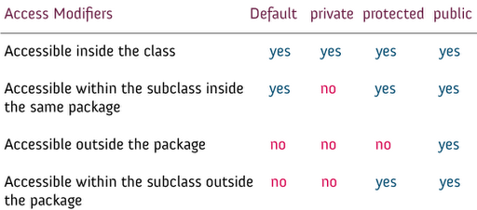
ACCESS SPECIFIERS

Slide 305
WRAPPER CLASSES IN JAVA
The wrapper class in Java provides the mechanism to convert primitive into object and object into primitive.
Since J2SE 5.0, autoboxing and unboxing feature convert primitives into objects and objects into primitives automatically.
The automatic conversion of primitive into an object is known as autoboxing and vice-versa unboxing.
Java is an object-oriented programming language, so we need to deal with objects many times like in Collections, Serialization, Synchronization, etc. Let us see the different scenarios, where we need to use the wrapper classes.

Slide 306
USES OF WRAPPER CLASSES
Change the value in Method: Java supports only call by value. So, if we pass a primitive value, it will not change the original value. But, if we convert the primitive value in an object, it will change the original value.
Serialization: We need to convert the objects into streams to perform the serialization. If we have a primitive value, we can convert it in objects through the wrapper classes.
Synchronization: Java synchronization works with objects in Multithreading.
java.util package: The java.util package provides the utility classes to deal with objects.
Collection Framework: Java collection framework works with objects only. All classes of the collection framework (ArrayList, LinkedList, Vector, HashSet, LinkedHashSet, TreeSet, PriorityQueue, ArrayDeque, etc.) deal with objects only.

Slide 307
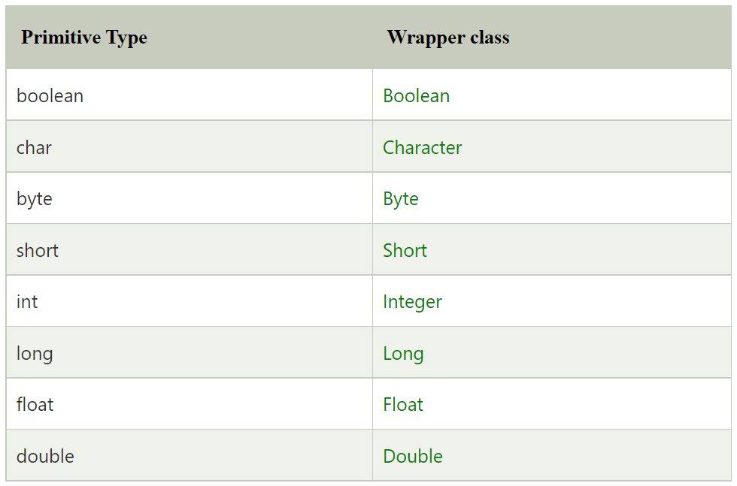

Slide 308
AUTOBOXING
The automatic conversion of primitive data type into its corresponding wrapper class is known as autoboxing, for example, byte to Byte, char to Character, int to Integer, long to Long, float to Float, boolean to Boolean, double to Double, and short to Short.
Since Java 5, we do not need to use the valueOf() method of wrapper classes to convert the primitive into objects.
class WrapperExample{
public static void main(String args[]){
int a=20;
Integer i=Integer.valueOf(a);
//converting int into Integer explicitly
Integer j=a;
//autoboxing, now compiler will write Integer.valueOf(a) internally
System.out.println(a+" "+i+" "+j);
}} Output: 20 20 20

Slide 309
UNBOXING
The automatic conversion of wrapper type into its corresponding primitive type is known as unboxing. It is the reverse process of autoboxing. Since Java 5, we do not need to use the intValue() method of wrapper classes to convert the wrapper type into primitives.
class WrapperExample{
public static void main(String args[]){
Integer a= new Integer(3);
int i=a.intValue();
//converting Integer to int explicitly
int j=a;
//unboxing, now compiler will write a.intValue() internally
System.out.println(a+" "+i+" "+j);
}} output: 3 3 3

Slide 310
CUSTOM WRAPPER CLASSES
Java Wrapper classes wrap the primitive data types, that is why it is known as wrapper classes. We can also create a class which wraps a primitive data type. So, we can create a custom wrapper class in Java.

Slide 311
MATH CLASS
Java Math class provides several methods to work on math calculations like min(), max(), avg(), sin(), cos(), tan(), round(), ceil(), floor(), abs() etc.
Unlike some of the StrictMath class numeric methods, all implementations of the equivalent function of Math class can't define to return the bit-for-bit same results. This relaxation permits implementation with better-performance where strict reproducibility is not required.
If the size is int or long and the results overflow the range of value, the methods addExact(), subtractExact(), multiplyExact(), and toIntExact() throw an ArithmeticException.
For other arithmetic operations like increment, decrement, divide, absolute value, and negation overflow occur only with a specific minimum or maximum value. It should be checked against the maximum and minimum value as appropriate.

Slide 312
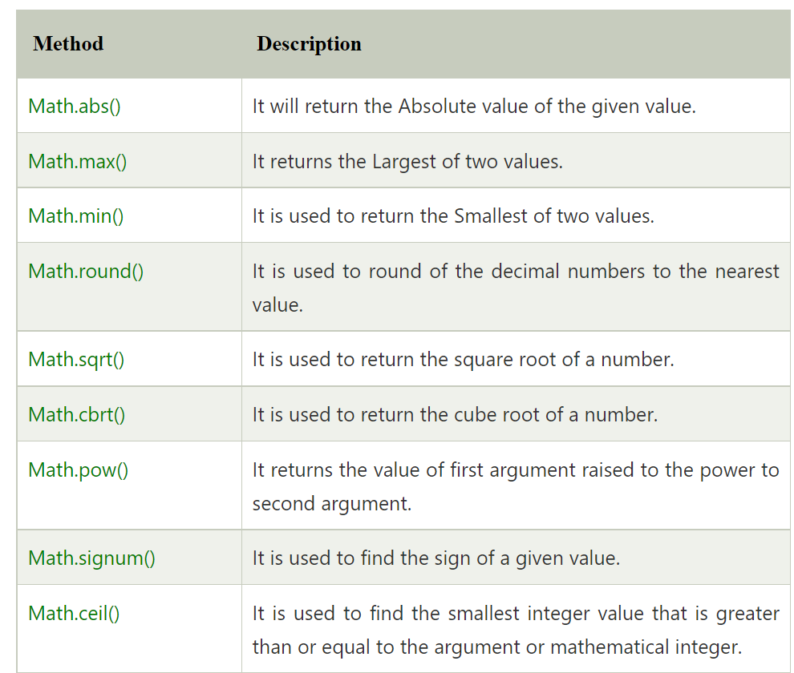

Slide 313
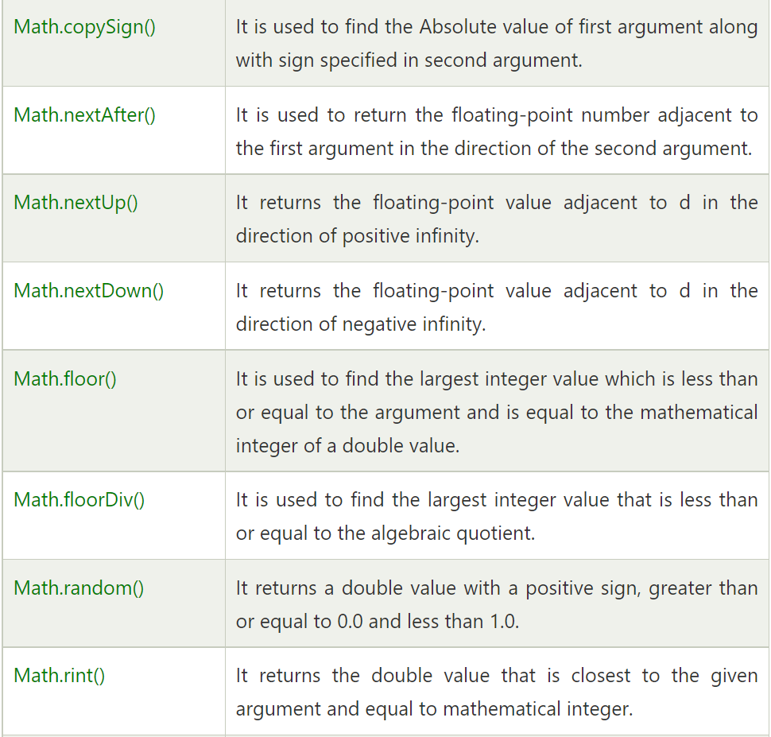

Slide 314


Slide 315


Slide 316


Slide 317


Slide 318
OBJECT ORIENTED PROGRAMMING
Lecture #34: Object class

Slide 319
OBJECT CLASS
The Object class is the parent class of all the classes in java by default
Object class is present in java.lang package
If a Class does not extend any other class then it is direct child class of Object and if extends other class then it is an indirectly derived
The Object class provides some common behaviors to all the objects such as object can be compared, object can be cloned, object can be notified etc.
String toString()
boolean equals(Object obj)
int hashCode()
Object clone()
void finalize()
class getclasss()
void wait()
void notify()
void notifyAll()

Slide 320
EQUALS
It is used to compare the two objects dynamically.
This method returns true if this object is the same as the obj argument; false otherwise.
Syntax:
public boolean equals(Object obj)

Slide 321
OBJECT CLONING
The object cloning is a way to create exact copy of an object.
The clone() method of Object class is used to clone an object.
The java.lang.Cloneable interface must be implemented by the class whose object clone we want to create
Advantages:
easy way of copying objects
don't need to write lengthy and repetitive codes.
Syntax:
protected Object clone() throws CloneNotSupportedException

Slide 322
class Student implements Cloneable{
int rollno;
String name;
Student(int rollno,String name){
this.rollno=rollno;
this.name=name;
}
public Object clone()throws CloneNotSupportedException{
return super.clone();
}
public static void main(String args[]){
try{
Student s1=new Student(101,"amit");
Student s2=(Student)s1.clone();
System.out.println(s1.rollno+" "+s1.name);
System.out.println(s2.rollno+" "+s2.name);
}
catch(CloneNotSupportedException c){}
}
}
Output:
101 amit
101 amit

Slide 323
REFLECTION
Reflection is an API which is used to examine or modify the behavior of methods, classes, interfaces at runtime.
There is a class in Java named “Class” that keeps all the information about objects and classes at runtime.
The object of “Class” can be used to perform reflection.
Steps:
create an object of Class.
using the object we can call various methods to get information about methods, fields, and constructors present in a class.

Slide 324
REFLECTION
Reflection can be used to get information about –
Class The getClass() method is used to get the name of the class to which an object belongs.
Constructors The getConstructors() method is used to get the public constructors of the class to which an object belongs.
Methods The getMethods() method is used to get the public methods of the class to which an objects belongs.

Slide 325
import java.lang.reflect.Method;
import java.lang.reflect.Field;
import java.lang.reflect.Constructor;
class Test
{
private String s;
public Test() { s = “Java Programming"; }
public void method1() {
System.out.println("The string is " + s);
}
}
System.out.println("The name of constructor is " + constructor.getName());
System.out.println("The public methods of class are : ");
Method[] methods = cls.getMethods();
System.out.println(method.getName());
}
}
Outpt:
The name of class is Test
The name of constructor is Test
The public methods of class are :
method1
class Demo
{
public static void main(String args[]) throws Exception
{
Test obj = new Test();
Class cls = obj.getClass();
System.out.println("The name of class is " + cls.getName());
Constructor constructor = cls.getConstructor();

Slide 326
RUNTIME JAVA CLASSES
Java Runtime class is used to interact with java runtime environment. Java Runtime class provides methods to execute a process, invoke GC, get total and free memory etc. There is only one instance of java.lang.Runtime class is available for one java application.
The Runtime.getRuntime() method returns the singleton instance of Runtime class.

Slide 327


Slide 328


Slide 329


Slide 330


Slide 331
COLLECTIONS IN JAVA
The Collection in Java is a framework that provides an architecture to store and manipulate the group of objects.
Java Collections can achieve all the operations that you perform on a data such as searching, sorting, insertion, manipulation, and deletion.
Java Collection means a single unit of objects. Java Collection framework provides many interfaces (Set, List, Queue, Deque) and classes (ArrayList, Vector, LinkedList, PriorityQueue, HashSet, LinkedHashSet, TreeSet).
What is Collection in Java
A Collection represents a single unit of objects, i.e., a group.

Slide 332
FRAMEWORK IN JAVA
What is a framework in Java
It provides readymade architecture.
It represents a set of classes and interfaces.
It is optional.
What is Collection framework
The Collection framework represents a unified architecture for storing and manipulating a group of objects. It has:
Interfaces and its implementations, i.e., classes
Algorithm

Slide 333

HIERARCHY OF COLLECTION FRAMEWORK

Slide 334


Slide 335


Slide 336


Slide 337
COLLECTION INTERFACE
The Collection interface is the interface which is implemented by all the classes in the collection framework.
It declares the methods that every collection will have.
In other words, we can say that the Collection interface builds the foundation on which the collection framework depends.
Some of the methods of Collection interface are Boolean add ( Object obj), Boolean addAll ( Collection c), void clear(), etc. which are implemented by all the subclasses of Collection interface.

Slide 338
LIST INTERFACE
List interface is the child interface of Collection interface. It inhibits a list type data structure in which we can store the ordered collection of objects. It can have duplicate values.
List interface is implemented by the classes ArrayList, LinkedList, Vector, and Stack.
To instantiate the List interface, we must use :
List <data-type> list1= new ArrayList();
List <data-type> list2 = new LinkedList();
List <data-type> list3 = new Vector();
List <data-type> list4 = new Stack();
There are various methods in List interface that can be used to insert, delete, and access the elements from the list.

Slide 339
ARRAYLIST
The ArrayList class implements the List interface. It uses a dynamic array to store the duplicate element of different data types. The ArrayList class maintains the insertion order and is non-synchronized. The elements stored in the ArrayList class can be randomly accessed. Consider the following example.
import java.util.*;
class TestJavaCollection1{
public static void main(String args[]){
ArrayList<String> list=new ArrayList<String>();//Creating arraylist
list.add(“akhila");//Adding object in arraylist
list.add(“rajesh");
list.add(“asha");
list.add(“mouli");
//Traversing list through Iterator
Iterator itr=list.iterator();
while(itr.hasNext()){
System.out.println(itr.next()); } } }
Output: akhila rajesh asha mouli

Slide 340
ARRAY LIST
Java ArrayList class uses a dynamic array for storing the elements.
It is like an array, but there is no size limit.
We can add or remove elements anytime.
So, it is much more flexible than the traditional array.
It is found in the java.util package.
It is like the Vector in C++.
The ArrayList in Java can have the duplicate elements also.
It implements the List interface so we can use all the methods of List interface here.
The ArrayList maintains the insertion order internally.
It inherits the AbstractList class and implements List interface.

Slide 341
ARRAY LIST
The important points about Java ArrayList class are:
Java ArrayList class can contain duplicate elements.
Java ArrayList class maintains insertion order.
Java ArrayList class is non synchronized.
Java ArrayList allows random access because array works at the index basis.
In ArrayList, manipulation is little bit slower than the LinkedList in Java because a lot of shifting needs to occur if any element is removed from the array list.

Slide 342

HIERARCHY OF ARRAYLIST CLASS
As shown in the above diagram, Java ArrayList class extends AbstractList class which implements List interface. The List interface extends the Collection and Iterable interfaces in hierarchical order.
ArrayList class declaration
Let's see the declaration for java.util.ArrayList class.
public class ArrayList<E> extends AbstractList<E> implements List<E>, RandomAccess, Cloneable, Serializable

Slide 343


Slide 344


Slide 345


Slide 346
LINKEDLIST
LinkedList implements the Collection interface. It uses a doubly linked list internally to store the elements. It can store the duplicate elements. It maintains the insertion order and is not synchronized. In LinkedList, the manipulation is fast because no shifting is required.
Consider the following example.
import java.util.*;
public class TestJavaCollection2{
public static void main(String args[]){
LinkedList<String> al=new LinkedList<String>();
al.add(“Akhila");
al.add(“Rajesh");
al.add(“Asha");
al.add(“Mouli");
Iterator<String> itr=al.iterator();
while(itr.hasNext()){
System.out.println(itr.next()); } } }
Output: Akhila Rajesh Asha Mouli

Slide 347
VECTOR
Vector uses a dynamic array to store the data elements. It is similar to ArrayList. However, It is synchronized and contains many methods that are not the part of Collection framework.
Consider the following example.
import java.util.*;
public class TestJavaCollection3{
public static void main(String args[]){
Vector<String> v=new Vector<String>();
v.add("Ayush");
v.add("Amit");
v.add("Ashish");
v.add("Garima");
Iterator<String> itr=v.iterator();
while(itr.hasNext()){
System.out.println(itr.next()); } } }

Slide 348
STACK
The stack is the subclass of Vector. It implements the last-in-first-out data structure, i.e., Stack. The stack contains all of the methods of Vector class and also provides its methods like boolean push(), boolean peek(), boolean push(object o), which defines its properties.
Consider the following example.
import java.util.*;
public class TestJavaCollection4{
public static void main(String args[]){
Stack<String> stack = new Stack<String>();
stack.push("Ayush");
stack.push("Garvit");
stack.push("Amit");
stack.push("Ashish");
stack.push("Garima");
stack.pop();
Iterator<String> itr=stack.iterator();
while(itr.hasNext()){
System.out.println(itr.next()); } } }

Slide 349
SET INTERFACE
Set Interface in Java is present in java.util package. It extends the Collection interface. It represents the unordered set of elements which doesn't allow us to store the duplicate items. We can store at most one null value in Set. Set is implemented by HashSet, LinkedHashSet, and TreeSet.
Set can be instantiated as:
Set<data-type> s1 = new HashSet<data-type>();
Set<data-type> s2 = new LinkedHashSet<data-type>();
Set<data-type> s3 = new TreeSet<data-type>();

Slide 350
HASH SET
HashSet class implements Set Interface. It represents the collection that uses a hash table for storage. Hashing is used to store the elements in the HashSet. It contains unique items.
Consider the following example.
import java.util.*;
public class TestJavaCollection7{
public static void main(String args[]){
//Creating HashSet and adding elements
HashSet<String> set=new HashSet<String>();
set.add("Ravi");
set.add("Vijay");
set.add("Ravi");
set.add("Ajay");
//Traversing elements
Iterator<String> itr=set.iterator();
while(itr.hasNext()){
System.out.println(itr.next()); } } }

Slide 351
HASH SET
Java HashSet class is used to create a collection that uses a hash table for storage. It inherits the AbstractSet class and implements Set interface.
The important points about Java HashSet class are:
HashSet stores the elements by using a mechanism called hashing.
HashSet contains unique elements only.
HashSet allows null value.
HashSet class is non synchronized.
HashSet doesn't maintain the insertion order. Here, elements are inserted on the basis of their hashcode.
HashSet is the best approach for search operations.
The initial default capacity of HashSet is 16, and the load factor is 0.75.
Difference between List and Set
A list can contain duplicate elements whereas Set contains unique elements only.

Slide 352

HIERARCHY OF HASHSET CLASS
The HashSet class extends AbstractSet class which implements Set interface. The Set interface inherits Collection and Iterable interfaces in hierarchical order.
HashSet class declaration
Let's see the declaration for java.util.HashSet class.
public class HashSet<E> extends AbstractSet<E> implements Set<E>, Cloneable, Serializable

Slide 353


Slide 354

METHODS IN JAVA

Slide 355
LINKED HASH SET
LinkedHashSet class represents the LinkedList implementation of Set Interface. It extends the HashSet class and implements Set interface. Like HashSet, It also contains unique elements. It maintains the insertion order and permits null elements.
Consider the following example.
import java.util.*;
public class TestJavaCollection8{
public static void main(String args[]){
LinkedHashSet<String> set=new LinkedHashSet<String>();
set.add("Ravi");
set.add("Vijay");
set.add("Ravi");
set.add("Ajay");
Iterator<String> itr=set.iterator();
while(itr.hasNext()){
System.out.println(itr.next()); } } }

Slide 356
TREE SET
Java TreeSet class implements the Set interface that uses a tree for storage. Like HashSet, TreeSet also contains unique elements. However, the access and retrieval time of TreeSet is quite fast. The elements in TreeSet stored in ascending order.
import java.util.*;
public class TestJavaCollection9{
public static void main(String args[]){
//Creating and adding elements
TreeSet<String> set=new TreeSet<String>();
set.add("Ravi");
set.add("Vijay");
set.add("Ravi");
set.add("Ajay");
//traversing elements
Iterator<String> itr=set.iterator();
while(itr.hasNext()){
System.out.println(itr.next()); } } }

Slide 357
HASH MAP
Java HashMap class implements the Map interface which allows us to store key and value pair, where keys should be unique.
If you try to insert the duplicate key, it will replace the element of the corresponding key.
It is easy to perform operations using the key index like updation, deletion, etc. HashMap class is found in the java.util package.
HashMap in Java is like the legacy Hashtable class, but it is not synchronized.
It allows us to store the null elements as well, but there should be only one null key.
Since Java 5, it is denoted as HashMap<K,V>, where K stands for key and V for value. It inherits the AbstractMap class and implements the Map interface.

Slide 358

HASH MAP
Java HashMap contains values based on the key.
Java HashMap contains only unique keys.
Java HashMap may have one null key and multiple null values.
Java HashMap is non synchronized.
Java HashMap maintains no order.
The initial default capacity of Java HashMap class is 16 with a load factor of 0.75.
Hierarchy of HashMap class
As shown in the above figure, HashMap class extends AbstractMap class and implements Map interface.

Slide 359
HASH MAP DECLARATION
Let's see the declaration for java.util.HashMap class.
public class HashMap<K,V> extends AbstractMap<K,V> implements Map<K,V>, Cloneable, Serializable
HashMap class Parameters
Let's see the Parameters for java.util.HashMap class.
K: It is the type of keys maintained by this map.
V: It is the type of mapped values.

Slide 360


Slide 361


Slide 362


Slide 363
EXAMPLE
import java.util.*;
public class HashMapExample1{
public static void main(String args[]){
HashMap<Integer,String> map=new HashMap<Integer,String>();
//Creating HashMap
map.put(1,"Mango"); //Put elements in Map
map.put(2,"Apple");
map.put(3,"Banana");
map.put(4,"Grapes");
System.out.println("Iterating Hashmap...");
for(Map.Entry m : map.entrySet()){
System.out.println(m.getKey()+" "+m.getValue()); } } }
Output: Iterating Hashmap…
Mango 2. Apple 3. Banana 4. Grapes
In this example, we are storing Integer as the key and String as the value, so we are using HashMap<Integer,String> as the type. The put() method inserts the elements in the map.
To get the key and value elements, we should call the getKey() and getValue() methods. The Map.Entry interface contains the getKey() and getValue() methods. But, we should call the entrySet() method of Map interface to get the instance of Map.Entry.

Slide 364
STRING TOKENIZER
The java.util.StringTokenizer class allows you to break a string into tokens. It is simple way to break string.
It doesn't provide the facility to differentiate numbers, quoted strings, identifiers etc. like StreamTokenizer class. We will discuss about the StreamTokenizer class in I/O chapter.
Constructors of StringTokenizer class
There are 3 constructors defined in the StringTokenizer class.

Slide 365


Slide 366


Slide 367
EXAMPLE
Let's see the simple example of StringTokenizer class that tokenizes a string "my name is khan" on the basis of whitespace.
import java.util.StringTokenizer;
public class Simple{
public static void main(String args[]){
StringTokenizer st = new StringTokenizer("my name is khan"," ");
while (st.hasMoreTokens()) {
System.out.println(st.nextToken()); } } }
Output: my
name
is
khan

Slide 368
NEXTTOKEN(STRING DELIM) METHOD OF STRINGTOKENIZER CLASS
StringTokenizer class is deprecated now. It is recommended to use split() method of String class or regex (Regular Expression).
import java.util.*;
public class Test {
public static void main(String[] args) {
StringTokenizer st = new StringTokenizer("my,name,is,khan");
// printing next token
System.out.println("Next token is : " + st.nextToken(",")); } }
Output: Next token is : my

Slide 369
CALENDER CLASS
Java Calendar class is an abstract class that provides methods for converting date between a specific instant in time and a set of calendar fields such as MONTH, YEAR, HOUR, etc. It inherits Object class and implements the Comparable interface.
Java Calendar class declaration
Let's see the declaration of java.util.Calendar class.
public abstract class Calendar extends Object
implements Serializable, Cloneable, Comparable<Calendar>

Slide 370
EXAMPLE
import java.util.Calendar;
public class CalendarExample1 {
public static void main(String[] args) {
Calendar calendar = Calendar.getInstance();
System.out.println("The current date is : " + calendar.getTime());
calendar.add(Calendar.DATE, -15);
System.out.println("15 days ago: " + calendar.getTime());
calendar.add(Calendar.MONTH, 4);
System.out.println("4 months later: " + calendar.getTime());
calendar.add(Calendar.YEAR, 2);
System.out.println("2 years later: " + calendar.getTime()); } }
Output:
The current date is : Thu Jan 19 18:47:02 IST 2017
15 days ago: Wed Jan 04 18:47:02 IST 2017
4 months later: Thu May 04 18:47:02 IST 2017
2 years later: Sat May 04 18:47:02 IST 2019

Slide 371
RANDOM CLASS
Java Random class is used to generate a stream of pseudorandom numbers. The algorithms implemented by Random class use a protected utility method than can supply up to 32 pseudorandomly generated bits on each invocation.
Random class is used to generate pseudo-random numbers in java. An instance of this class is thread-safe. The instance of this class is however cryptographically insecure. This class provides various method calls to generate different random data types such as float, double, int.
Constructors:
Random(): Creates a new random number generator
Random(long seed): Creates a new random number generator using a single long seed

Slide 372


Slide 373
OBJECT ORIENTED PROGRAMMING
Lecture #36: Graphics Programming

Slide 374
JAVA APPLET
Applet is a special type of program that is embedded in the webpage to generate the dynamic content. It runs inside the browser and works at client side.
Advantage of Applet
It works at client side so less response time.
Secured
It can be executed by browsers running under many plateforms, including Linux, Windows, Mac Os etc.
Applets can perform arithmetic operations, display graphics, play sounds, accepts user inputs, creates animations

Slide 375
APPLETS
How applets differ from applications:
Applets do not use main() method
Applets cannot run independently. They run inside a webpage using HTML code
Applets cannot read from or write to the files in the local computer
Applet are restricted from using libraries from other languages such as C or C++.
These restrictions ensure security and cannot do any damage to the local system

Slide 376
APPLETS
Steps involved in developing and testing an applet are:
Building an applet code (.java code)
Creating an executable applet (.class file)
Designing a webpage using HTML tags
Preparing <APPLET> tag
Incorporating <APPET> tag into web page(creating HTML file)
Testing the applet code.

Slide 377

1. BUILDING AN APPLET
Applet Life cycle:
java.applet.Applet class
For creating any applet java.applet.Applet class must be inherited. It provides 4 life cycle methods of applet.
public void init(): is used to initialized the Applet. It is invoked only once.
public void start(): is invoked after the init() method or browser is maximized. It is used to start the Applet.
public void stop(): is used to stop the Applet. It is invoked when Applet is stop or browser is minimized.
public void destroy(): is used to destroy the Applet. It is invoked only once.
java.awt.Component class
The Component class provides 1 life cycle method of applet.
public void paint(Graphics g): is used to paint the Applet. It provides Graphics class object that can be used for drawing oval, rectangle, arc etc.

Slide 378

import java.applet.*;
import java.awt.*;
public class appletclassname extends Applet
{
...............
...............
public void paint( Graphics g)
{
............... // Applet operations code
...............
}
...............
...............
}
Hierarchy of Applet------>
import java.applet.*;
import java.awt.*;
public class Helloapplet extends Applet
{
public void paint( Graphics g)
{
g.drawString(“Hello Java”,10,100);
}
}
Helloapplet.java

Slide 379
2. CREATING AN EXECUTABLE APPLET (.CLASS FILE)
.class file is obtained by compiling the source codeof the applet.
this generates Helloapplet.class file.
javac Helloapplet.java

Slide 380
3. DESIGNING A WEBPAGE USING HTML TAGS
In order to run a java applet, it is first necessary to have a webpage that references the applet.
Web page is made with HTML tags.
<APPLET> tag is used.
<HTML>
<HEAD>
...
</HEAD>
<BODY>
....
</BODY>
</HTML>

Slide 381
4.PREPARING <APPLET> TAG
<APPLET> tag supplies the name of the applet to be loaded and tells trowser how much space required by the applet.
This specifies three things
name of the applet
Width of the applet(in pixels)
Height of the applet(in pixels)
Example:
<APPLET
code=Helloapplet.class
width=400
height=200 >
</APPLET>

Slide 382
5. CREATING HTML FILE
<HTML>
<HEAD>
<TITLE> Welcome to Java Applets</TITLE>
</HEAD>
<BODY>
<APPLET
code=Helloapplet.class
width=400
height=200 >
</APPLET>
</BODY>
</HTML>
Helloapplet.html

Slide 383
6.TESTING THE APPLET CODE.
Our current directory will have following things:
Helloapplet.java
Helloapplet.class
Helloapplet.html
To run an applet, we require one of the folowing:
java enabled web browser(entire webpage can be seen)
java applet viewer(only applet output)
Syntax:
appletviewer Helloapplet.html

Slide 384
OBJECT ORIENTED PROGRAMMING
Lecture #37: Graphics Programming
(Devoloping and Testing an Applet)

Slide 385
JAVA APPLET
Applet is a special type of program that is embedded in the webpage to generate the dynamic content. It runs inside the browser and works at client side.
Advantage of Applet
It works at client side so less response time.
Secured
It can be executed by browsers running under many plateforms, including Linux, Windows, Mac Os etc.
Applets can perform arithmetic operations, display graphics, play sounds, accepts user inputs, creates animations

Slide 386
APPLETS
Steps involved in developing and testing an applet are:
Building an applet code (.java code)
Creating an executable applet (.class file)
Designing a webpage using HTML tags
Preparing <APPLET> tag
Incorporating <APPET> tag into web page(creating HTML file)
Testing the applet code.

Slide 387
import java.applet.*;
import java.awt.*;
public class Helloapplet extends Applet
{
public void paint( Graphics g)
{
g.drawString(“Hello Java”,10,100);
}
}
Helloapplet.java
Helloapplet.html
<HTML>
<HEAD>
<TITLE> Welcome to Java Applets</TITLE>
</HEAD>
<BODY>
<APPLET
code=Helloapplet.class
width=400
height=200 >
</APPLET>
</BODY>
</HTML>
Helloapplet.class
javac Helloapplet.java

Slide 388


To run an applet, we require one of the folowing:
java enabled web browser(entire webpage can be seen)
java applet viewer(only applet output)
Syntax:
appletviewer Helloapplet.html
Applet Window------>

Slide 389
WORKING WITH 2D SHAPES
Graphics class includes methods for drawing many different types of shapes.
Coordinate System of java
x
(0,0)
(50,0)
 | (0,20)
y
(0,60)
(50,60)

Slide 390

DRAWING METHODS
Graphics class

Slide 391
OBJECT ORIENTED PROGRAMMING
Lecture #38: Nested class/Inner class

Slide 392
INNER CLASS OR NESTED CLASS
In java, just like methods and varibles, it can have a class too.
Java inner class or nested class is a class which is declared inside the class or interface.
Syntax:
class Java_Outer_class{
//code
class Java_Inner_class{
//code
}
}

Slide 393
INNER CLASS OR NESTED CLASS
Types of Nested classes
Two types
Static nested class
Non-static nested class (inner class)
Member inner class
Anonymous inner class
Local inner class

Slide 394
STATIC NESTED CLASS
A static class i.e. created inside a class is called static nested class in java
static inner class instance can be created outside the class using following Syntax
Syntax:
class Java_Outer_class{
//code
static class Java_Inner_class{
//code
}
}
No need to create outer class object
Syntax:
Outer.Inner o1=new Oute.Inner();

Slide 395
STATIC NESTED CLASS
Rules:
It can be accessed by outer class name.
Static nested class cannot access non-static (instance) data member or method.
It can access static data members of outer class including private.
static inner class can be public, private, protected and default
Outer class should be public or default.

Slide 396
INNER CLASS OR NESTED CLASS
Types of Nested classes
Two types
Static nested class
Non-static nested class (inner class)
Member inner class
Anonymous inner class
Local inner class

Slide 397
NON-STATIC NESTED CLASS (INNER CLASS)
Member inner class
A non-static class that is created inside a class but outside a method is called member inner class.
Outer class Object is required.
Syntax:
class Java_Outer_class{
//code
class Java_Inner_class{
//code
}
}
Example

Slide 398
NON-STATIC NESTED CLASS (INNER CLASS)
Anonymous inner class
A class that have no name is known as anonymous inner class in java.
It should be used if you have to override method of class or interface.
Example

Slide 399
NON-STATIC NESTED CLASS (INNER CLASS)
Local inner class
A class i.e. created inside a method is called local inner class in java.
If you want to invoke the methods of local inner class, you must instantiate this class inside the method.
Example

Slide 400
OBJECT ORIENTED PROGRAMMING
Lecture #39: Event Handling
(Introduction)

Slide 401
EVENT HANDLING
Event?
Change in the state of an object is known as event i.e. event describes the change in state of source.
Events are generated as result of user interaction with the graphical user interface components.
For example: press a button, enter a character in textbox, click or drag a mouse, etc.
Event Handling?
Event Handling is the mechanism that controls the event and decides what should happen if an event occurs.
This mechanism have the code which is known as event handler that is executed when an event occurs. (Delegation Event Model)

Slide 402
DELEGATION EVENT MODEL)
Benifit:
User interface design is seperated from event handler
key participants
Source
The source is an object on which event occurs.
Listener
It is also known as event handler. Listener is responsible for generating response to an event.
Source
Listener
Register
State Change
Java Code
Seperate Java Code
Click Here
Event Oocurs
Delegating event processing
Response

Slide 403
EVENT HANDLING
Button
Checkbox
List
Menuitem
Choice
Scrollbar
Textcomponent
window
Source
Listener
Interfaces
Events
sent to
Generates Events
Listerners have to register to sources
Syntax: addTypeListener()

Slide 404
EVENT HANDLING
import java.awt.event.* paclage
Event Classes
Source
Interfaces
ActionEvent
AdjustmentEvent
ComponentEvent
ContainerEvent
FocusEvent
ItemEvent
KeyEvent
MouseEvent
MouseWheelEvent
TextEvent
WindowEvent
Button, Menuitem,List
Component
Component
Component
Component
Checkbox,choice
Textcomponent
Mouse movements
MouseWheelmovement
Textcomponent
Window
ActionListener
AdjustmentListner
ComponentListener
ContainerListner
FocusListener
ItemListener
KeyListener
MouseListener,MouseMotionListener
MouseWheelListener
TextListener
WindowListener

Slide 405
EVENT HANDLING
Template:
1. import packages
2. Class should extend the Applet class and implement the interfaces
3. Write applet code
4. init() method: Register the Listener interface
5. Write Event methods defintion
import java.awt.*;
java.awt.event.*;
java.applet.*;
Syntax: addTypeListener()

Slide 406
OBJECT ORIENTED PROGRAMMING
Lecture #40: Mouse Events

Slide 407
EVENT HANDLING
Event?
Change in the state of an object is known as event i.e. event describes the change in state of source.
Events are generated as result of user interaction with the graphical user interface components.
For example: press a button, enter a character in textbox, click or drag a mouse, etc.
Event Handling?
Event Handling is the mechanism that controls the event and decides what should happen if an event occurs.
This mechanism have the code which is known as event handler that is executed when an event occurs. (Delegation Event Model)

Slide 408
EVENT HANDLING
Button
Checkbox
List
Menuitem
Choice
Scrollbar
Textcomponent
window
Source
Listener
Interfaces
Events
sent to
Generates Events
Listerners have to register to sources
Syntax: addTypeListener()

Slide 409
EVENT HANDLING
Event Classes
Source
Interfaces
ActionEvent
AdjustmentEvent
ComponentEvent
ContainerEvent
FocusEvent
ItemEvent
KeyEvent
MouseEvent
MouseWheelEvent
TextEvent
WindowEvent
Button, Menuitem,List
Component
Component
Component
Component
Checkbox,choice
Textcomponent
Mouse movements
MouseWheelmovement
Textcomponent
Window
ActionListener
AdjustmentListner
ComponentListener
ContainerListner
FocusListener
ItemListener
KeyListener
MouseListener,MouseMotionListener
MouseWheelListener
TextListener
WindowListener

Slide 410
MOUSE EVENTS
Class
Interfaces
Methods
mousePressed(),
mouseClicked(),
mouseEntered(),
mouseExited(),
mouseReleased()
mouseMoved(),
mouseDragged
getX(), getY()
MouseEvent
MouseListener
MouseMotionListener

Slide 411
MOUSE EVENTS
Example
Template:
1. import packages
2. Class should extend the Applet and implement the interfaces (MouseListener, MouseMotionListener)
3. Write applet code
4. init() method: Register the Listener interface
5. Write Event methods defintion
import java.awt.*;
java.awt.event.*;
java.applet.*;
Syntax: addMouseeListener()
addMouseMotionListener()

Slide 412
OBJECT ORIENTED PROGRAMMING
Lecture #41: AWT Hierarchy

Slide 413
OBJECT ORIENTED PROGRAMMING
Lecture #42: Layout managers

Slide 414


AWT VERSUS SWING

Slide 415


Slide 416
Java Generic Methods or generic classes enable Programmers to specify, with a single method declarations, a set of related methods or, with a single class declaration, a set of related types.

Slide 417
GENERIC METHODS
We can write a single method declaration that can be called with arguments of different types.
Rules:
All genreic method declarations have a type parameter section deleimted by angle brackets(< and >) that precedes the methods return type
Each type paramenter section contains one or more type parameters seperated by commas
The type parameter can be used to declare the return type
Type parameters can represent only reference types not primitive types(like int, double and char)

Slide 418
GENERIC CLASSES
Java Generic Methods or generic classes enable Programmers to specify, with a single method declarations, a set of related methods or, with a single class declaration, a set of related types.
Rules:
Genreic class declaration looks like a non-generic class declaration, except that the class name is followed by a type parameter section.
As with Generic methods, the type parament section of a generic class can have one or more type paramenters seperated by commas

Slide 419
OBJECT ORIENTED PROGRAMMING
Lecture #54: Generic and Inheritance

Slide 420
GENERIC AND INHERITANCE
A class aquring the proprties of another class-Inheritance.
Java Generic Methods or generic classes enable Programmers to specify, with a single method declarations, a set of related methods or, with a single class declaration, a set of related types.
3 different ways of Generic and Inheritance
Only Super class is Genreic
Only Subclass is Generic
Super and Sub class both are Generic

Slide 421
ONLY SUPER CLASS IS GENREIC
class SuperA<T>
{
T a;
SuperA(T n)
{
a=n;
}
T getA()
{
return a;
}
}
class SubA extends SuperA<T>
{
SubA(Integer n1)
{
super(n1);
}
}
Output:
10
class Ex
{
public static void main(String args[])
{
SubA<Integer> s=new SubA<Integer>(10);
System.out.println(s.getA());
}
}

Slide 422
ONLY SUBCLASS IS GENERIC
class SuperA
{
int a;
SuperA(int n)
{
a=n;
}
int getA()
{
return a;
}
}
class SubA<T> extends SuperA{
T t;
SubA(Integer n1, T x)
{
super(n1);
t=x;
}
T gett()
{
return t;
}}
class Ex
{
public static void main(String args[])
{
SubA<String> s=new SubA<String>(10,”Jyothi”);
System.out.println(s.getA());
System.out.println(s.gett());
}
}
Output:
10
Jyothi

Slide 423
SUPER AND SUB CLASS BOTH ARE GENERIC
class SuperA<T>
{
T a;
SuperA(T n)
{
a=n;
}
T getA()
{
return a;
}
}
class SubA<T> extends SuperA<T>
{
SubA(T n1)
{
super(n1);
}
}
Output:
10
Jyothi
class Ex
{
public static void main(String args[])
{
SubA<Integer> s=new SubA<Integer>(10);
System.out.println(s.getA());
SubA<String> s1=new SubA<String>(“Jyothi”);
System.out.println(s1.getA());
}
}

Slide 424
GENERIC AND INHERITANCE
3 different ways of Generic and Inheritance
Only Super class is Genreic
Only Subclass is Generic
Super and Sub class both are Generic
subclass is free to use its own type parameters if needed

Slide 425
SUBCLASS IS FREE TO USE ITS OWN TYPE PARAMETERS IF NEEDED
class SuperA<T>
{
T a;
SuperA(T n)
{
a=n;
}
T getA()
{
return a;
}
}
class SubA<T> extends SuperA<T>
{
SubA(T n1)
{
super(n1);
}
}
Output:
10
Jyothi
class Ex
{
public static void main(String args[])
{
SubA<Integer> s=new SubA<Integer>(10);
System.out.println(s.getA());
SubA<String> s1=new SubA<String>(“Jyothi”);
System.out.println(s1.getA());
}
}

Slide 426
SUBCLASS IS FREE TO USE IYS OWN TYPE PARAMETERS IF NEEDED
class SuperA<T>
{
T a;
SuperA(T n)
{
a=n;
}
T getA()
{
return a;
}
}
Output:
10
Jyothi
class SubA<T,V> extends SuperA<T>
{ V t;
SubA(T n1, T x)
{
super(n1);
t=x;
}
V gett()
{
return t;
}
}
class Ex
{
public static void main(String args[])
{
SubA<Integer, String> s=new SubA<Integer,String> (10,“Jyothi”);
System.out.println(s.getA());
System.out.println(s.gett());
}
}

Slide 427
OVERRIDING METHODS OF GENRIC CLASS
class SuperA<T>
{
T a;
SuperA(T n)
{
a=n;
}
T getA()
{
return a;
}
}
class SubA<T> extends SuperA<T>
{
SubA(T n1)
{
super(n1);
}
T getA()
{
return a;
}
}
Output:
10
20
Jyothi
class Ex
{
public static void main(String args[])
{
SuperA<Integer> s1=new SuperA<Integer> (10);
SubB<Integer> s2=new SubB<Integer> (20);
SubB<String> s3=new SubB<String> (“Jyothi”);
System.out.println(s1.getA());
System.out.println(s2.getA());
System.out.println(s3.getA());
}
}

